Slide 1


Presentation on:
Identifying Influential Biomarkers of Colorectal Cancer using Bioinformatics and Machine Learning approaches with Explainable AI
Defense
Presented by:
Farhana Akter Suci
Rifah Sajida Deya
Department of Computer Science and Engineering,
Jagannath University, Dhaka
Supervised by:
Dr. Mohammed Nasir Uddin
Professor,
Department of Computer Science and Engineering,
Jagannath University, Dhaka
19 August, 2025
Department Of Computer Science and Engineering, JnU
1

Slide 2



Outlines
1
6
Introduction
Result Evaluation
2
7
Research Goal
Model Interpretation
3
8
Related Works
Biological Validation & Immune Infiltration Analysis
4
9
Proposed Methodology
Discussion
5
10
Data Preparation
Conclusion and Future Works
Department Of Computer Science and Engineering, JnU
2

Slide 3
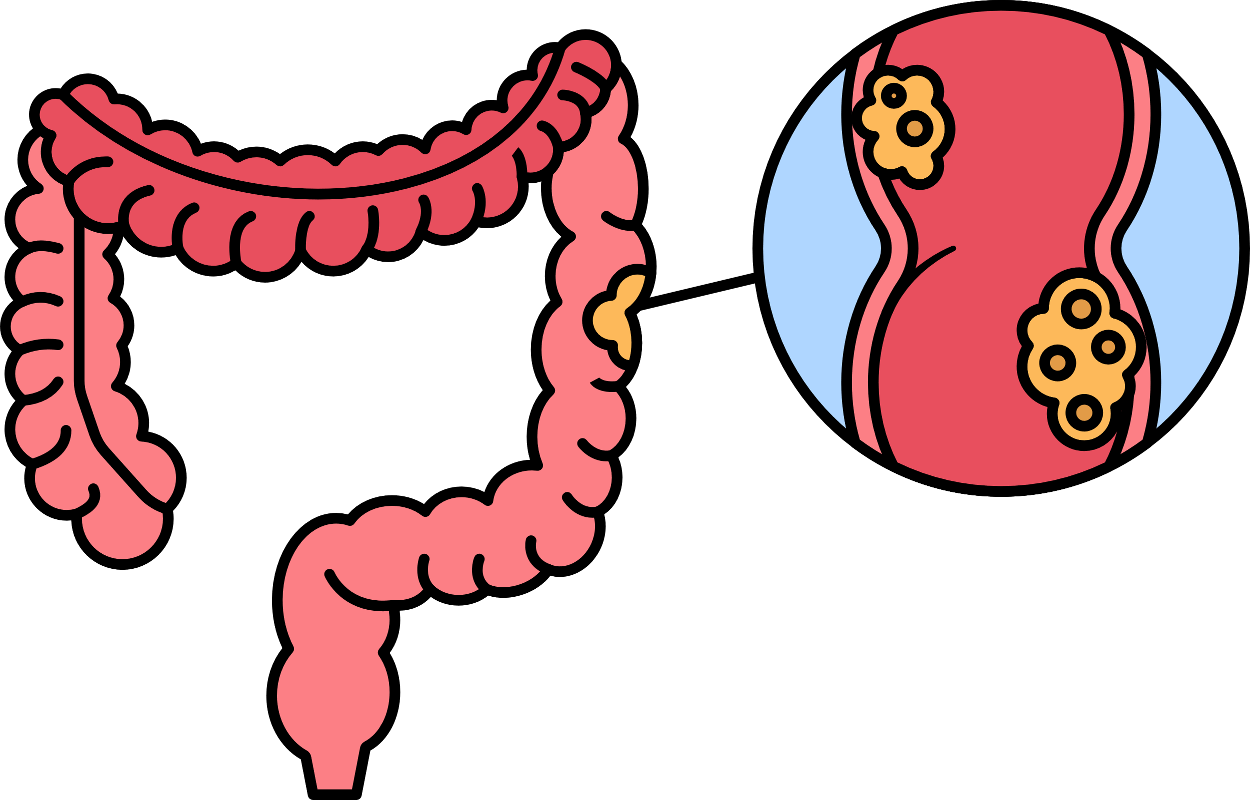
Introduction
Colorectal cancer (CRC), also known as bowel cancer, colon cancer, or rectal cancer, is the development of cancer from the colon or rectum (parts of the large intestine).
Most colorectal cancers are due to lifestyle factors and genetic disorders.
Department Of Computer Science and Engineering, JnU
3

Slide 4
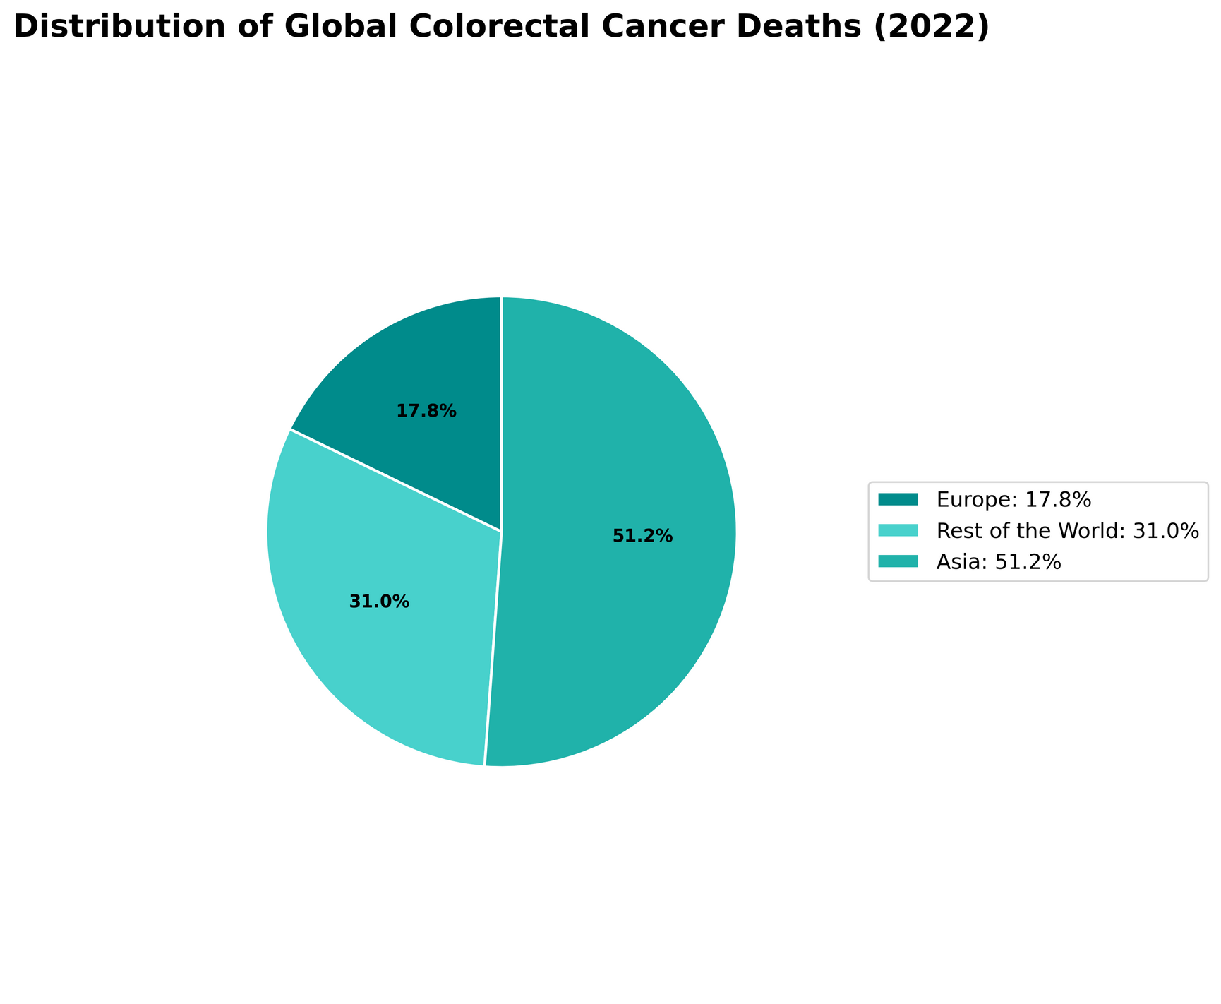
Introduction (cont..)
According to GLOBOCAN recent study shows that, almost 1.93 million people were diagnosed with colorectal cancer and approximately 9,35,000 people died worldwide [1].
Asia was home to approximately 9,66,400 colorectal cancer cases and 4,62,300 deaths—almost half of the global burden. On the other hand, Europe had 3,61,986 colorectal cancer cases and 1,61,182 deaths. [2]
Figure 1.1 : Distribution of Global Colorectal Cancer Deaths
Department Of Computer Science and Engineering, JnU
4

Slide 5

Research Goal
Create a reusable pipeline for colon cancer biomarker discovery using bioinformatics and machine learning approaches.
Test the biomarkers on different datasets to check their accuracy and reliability.
Apply Explainable AI (e.g., SHAP) to understand how each selected gene affects the model’s predictions.
Validate the gene biomarkers by GEPIA2 and perform immune infiltration analysis to examine their prognostic value and links to immune cell presence in tumors.
Department Of Computer Science and Engineering, JnU
5

Slide 6
Related Works
Authors | Methods/Models | Accuracy
Radhakrishnan et al. [6] | LASSO, XGBoost, LightGBM, SHAP | 94.87%
Minh et al. [4] | SVM, DNN, KNN, RF, NB | 94%
Bera et al. [7] | Bioinformatics approaches, SVM, LR, KNN, RF, XGBoost | 97%
Yoon et al. [8] | Hybrid Bioinformatics approach | 98.69% (AUC)
Vaziri-Moghadam et al. [3] | LASSO, RF, SVM, ANN | 95.8% - 97.8%
Hasan et al. [9] | WGCNA, SVM | 98% (AUC)
Wei et al. [5] | SVM, XGBoost, RF, KNN | 96.4% - 98.2%
Du et al. [10] | Hybrid bioinformatics approach | 77% (AUC)
Table 3.1 : Recent Related Works on Identifying CRC Biomarkers
Department Of Computer Science and Engineering, JnU
6

Slide 7
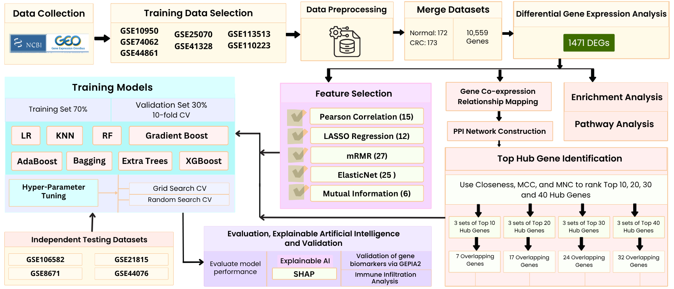
Proposed Methodology
Figure 4.1: Workflow of the proposed methodology
Department Of Computer Science and Engineering, JnU
7

Slide 8
Data Preparation
11 Individual datasets Collected from GEO
Handling Missing Values
Data Reshaping
Data Consolidation
Encoding target class
Data Annotation
For training purpose, merging 7 datasets
Remaining 4 individual datasets for testing
Figure 5.1: Data preparation pipeline
Department Of Computer Science and Engineering, JnU
10

Slide 9
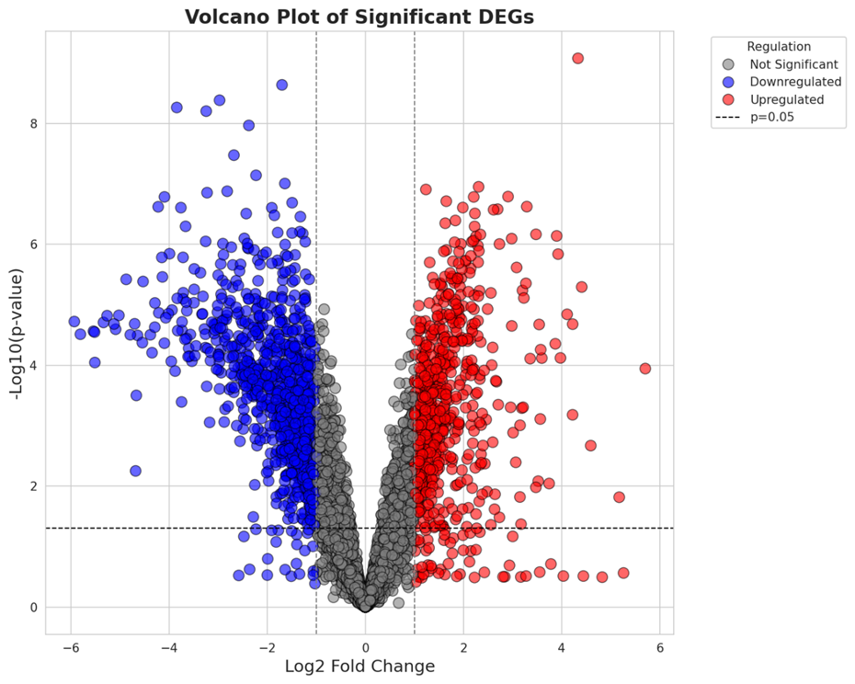
Result Evaluation
After DEG:
Total significant genes found 1471
There are upregulated and downregulated genes.
There are 564 upregulated and 907 downregulated genes.
Figure 6.1: Volcano Plot on DEGs
Department Of Computer Science and Engineering, JnU
10

Slide 10
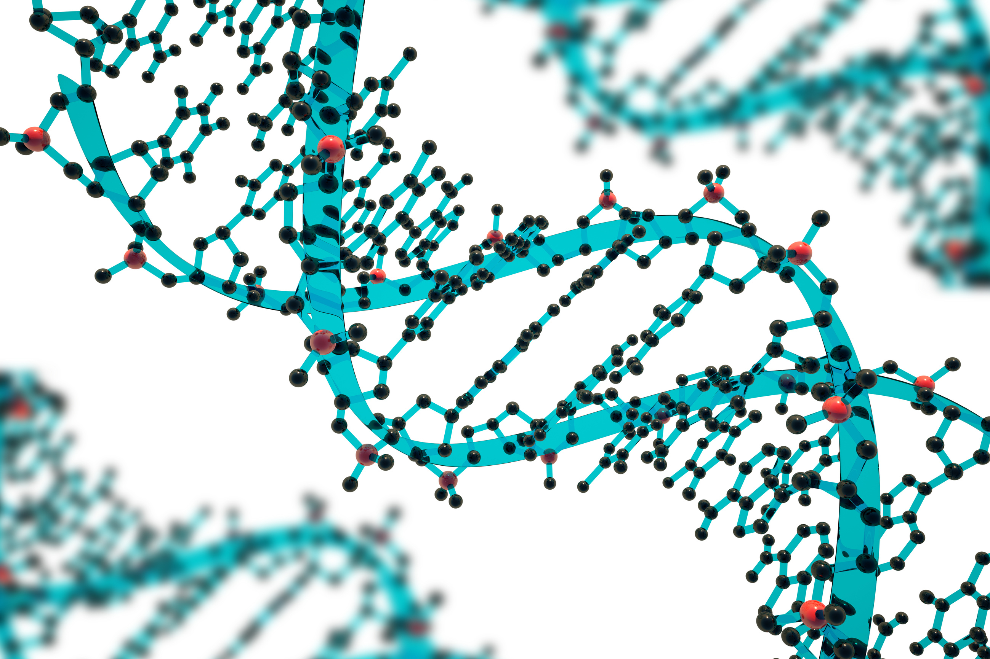
Result Evaluation (cont..)
Gene Enrichment and Pathway Analysis
Gene Enrichment Analysis:
Gene Ontology (GO) enrichment analysis was performed separately on the upregulated and downregulated DEGs to identify the most significantly overrepresented biological terms in three GO categories:
Biological Process (BP),
Molecular Function (MF), and
Cellular Component (CC).
Department Of Computer Science and Engineering, JnU
11

Slide 11
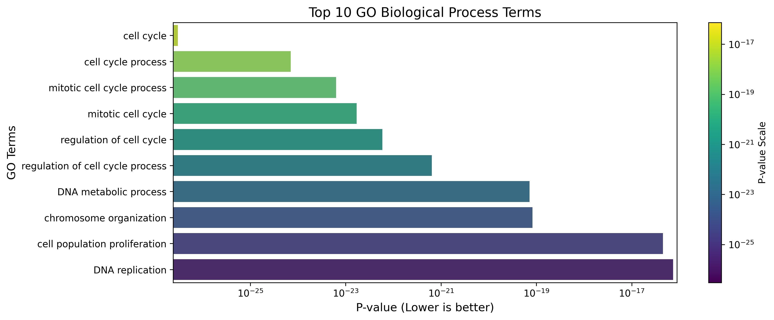
Result Evaluation (cont..)
GO in Upregulated Genes
Biological Process (BP):
The terms we can see in the chart, indicate that the upregulated genes are strongly associated with active cell division and DNA synthesis processes.
Figure 6.2: Top 10 GO biological process terms for upregulated DEGs
Department Of Computer Science and Engineering, JnU
12

Slide 12
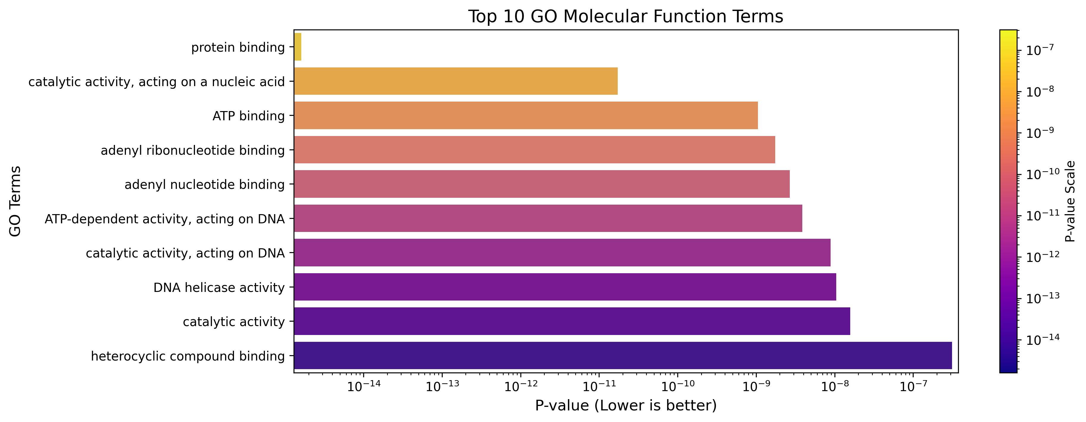
Result Evaluation (cont..)
Molecular Function (MF):
The terms we can see in the chart, these functions are typically involved in DNA replication and repair mechanisms, which align with the BP findings.
Figure 6.3: Top 10 GO molecular function terms for upregulated DEGs
Department Of Computer Science and Engineering, JnU
13

Slide 13
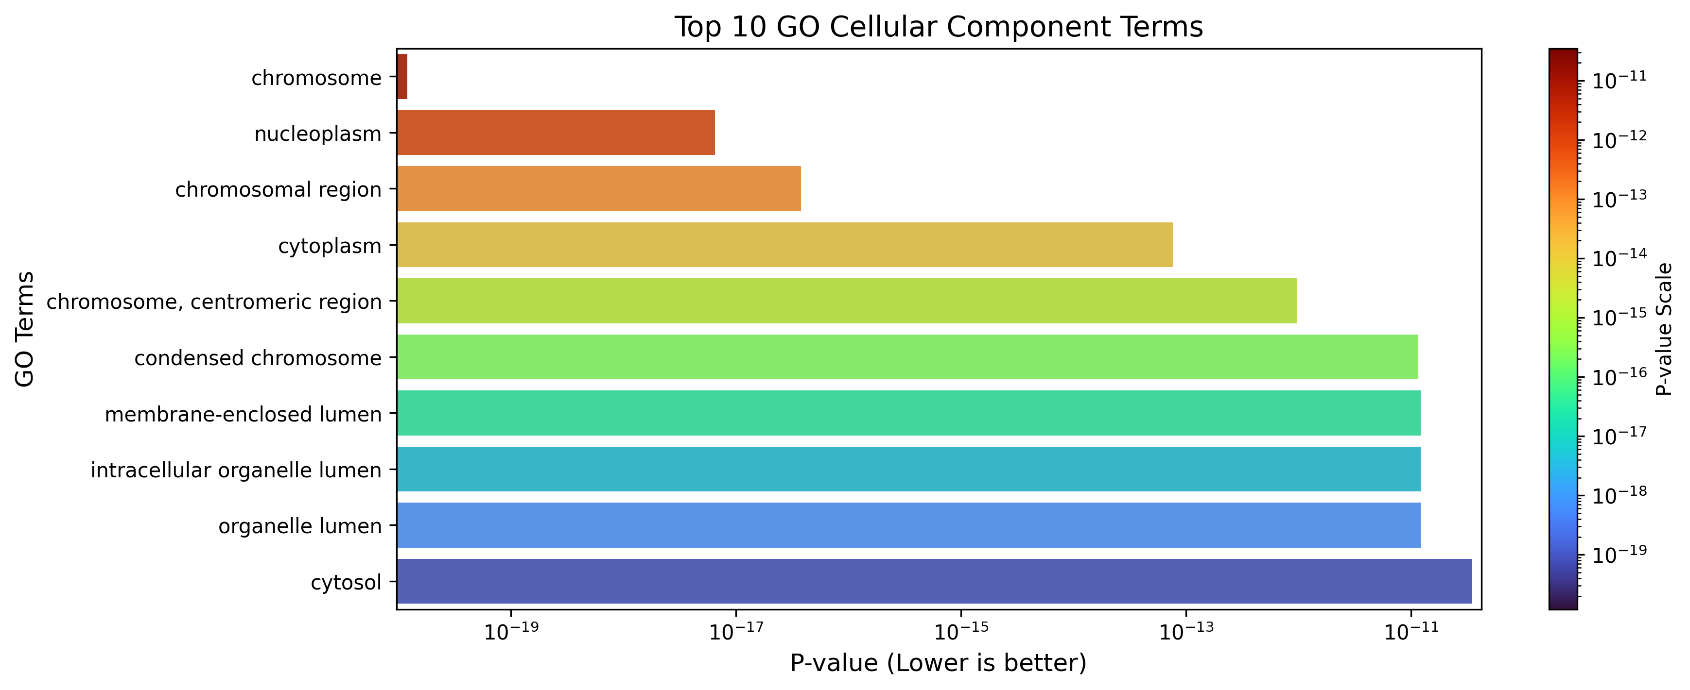
Result Evaluation (cont..)
Cellular Component (CC):
The terms we can see in the chart, indicates that that the upregulated genes are mostly localized within the nucleus and chromosomal structures.
Figure 6.4: Top 10 GO cellular components terms for upregulated DEGs
Department Of Computer Science and Engineering, JnU
14

Slide 14
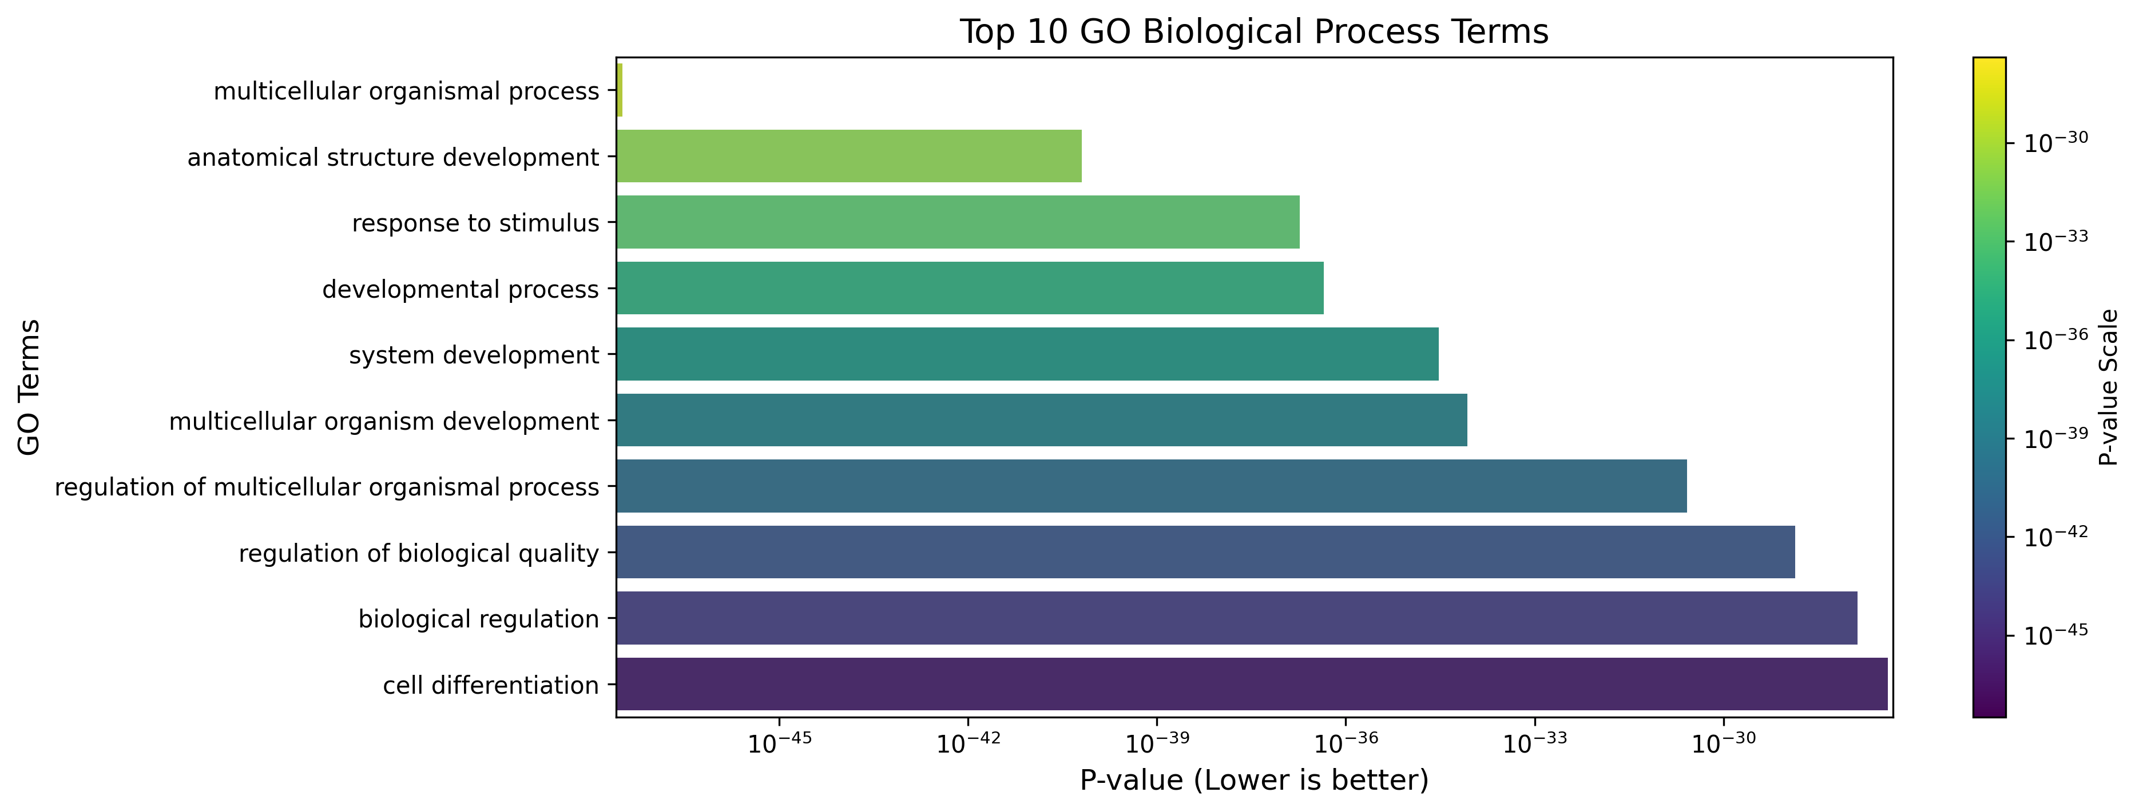
Result Evaluation (cont..)
GO in Downregulated Genes
Biological Process (BP):
The terms we can see in the chart, indicates potential suppression of differentiation and signaling pathways .
Figure 6.5: Top 10 GO biological process terms for downregulated DEGs
Department Of Computer Science and Engineering, JnU
15

Slide 15
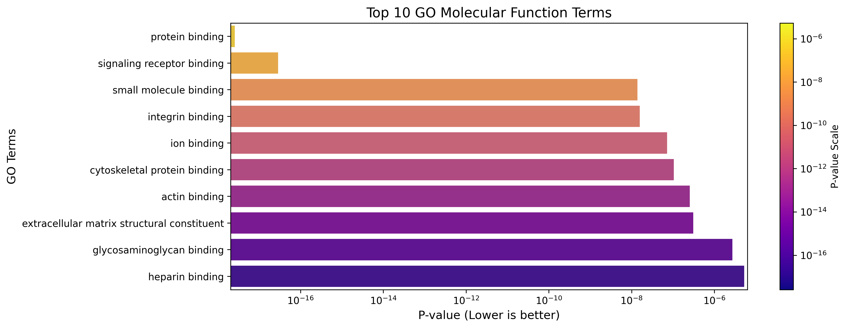
Result Evaluation (cont..)
Molecular Function (MF):
The terms we can see in the chart, these functions points to reduced receptor-mediated signaling and cell-matrix interactions.
Figure 6.6: Top 10 GO molecular function terms for downregulated DEGs
Department Of Computer Science and Engineering, JnU
16

Slide 16
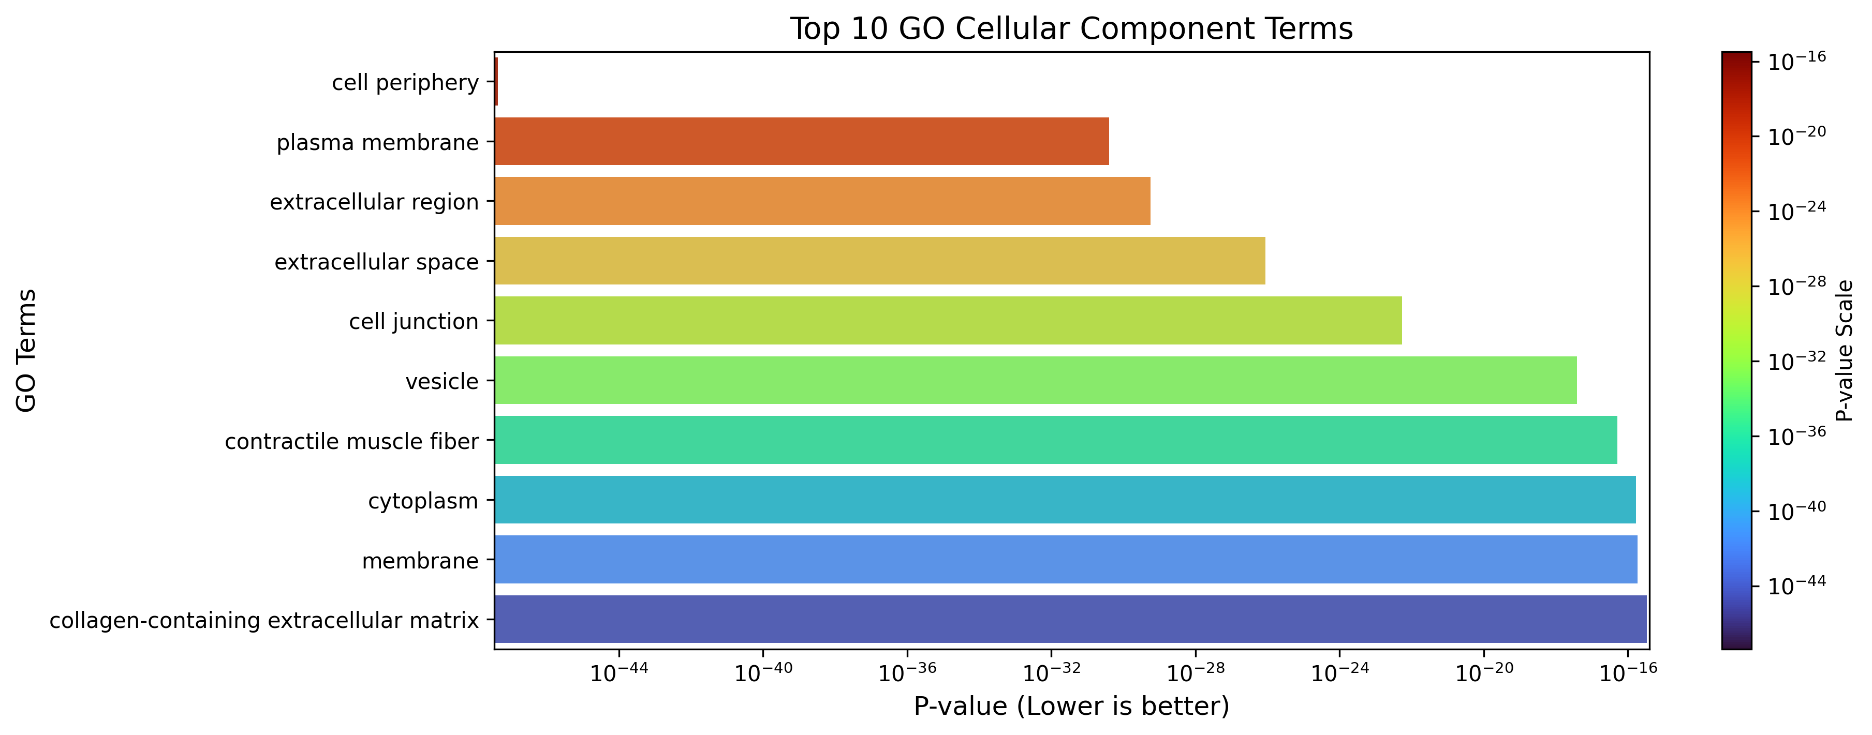
Result Evaluation (cont..)
Cellular Component (CC):
The terms we can see in the chart, indicates a possible downregulation of extracellular signaling structures and cytoskeletal components.
Figure 6.7: Top 10 GO cellular components terms for upregulated DEGs
Department Of Computer Science and Engineering, JnU
17

Slide 17

Result Evaluation (cont..)
Gene Pathway Analysis:
Gene pathway analysis was performed separately on the upregulated and downregulated DEGs to identify the most significantly overrepresented biological terms in two categories:
Kyoto Encyclopedia of Genes and Genomes (KEGG),
Reactome Pathway Database (REAC)
Department Of Computer Science and Engineering, JnU
18

Slide 18
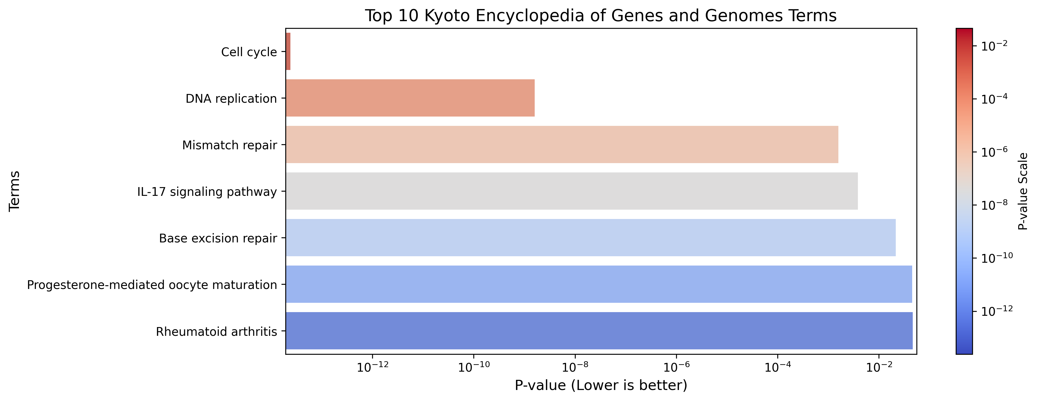
Result Evaluation (cont..)
KEGG in Upregulated Genes:
Here the terms show, enrichment was observed in immune-related pathways such as IL-17 signaling and rheumatoid arthritis, suggesting a possible link to inflammatory responses.
Figure 6.8: Top KEGG terms for upregulated DEGs
Department Of Computer Science and Engineering, JnU
19

Slide 19
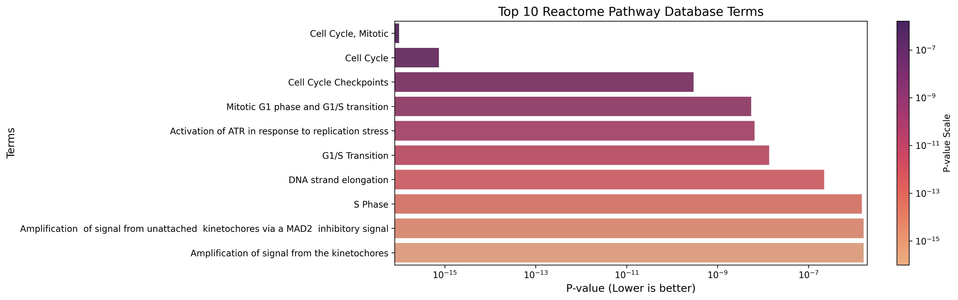
Result Evaluation (cont..)
REAC in Upregulated Genes:
The most enriched REAC terms included Cell Cycle, Mitotic, G1/S Transition, and DNA strand elongation, further reinforcing the involvement of upregulated genes in cell division and DNA processing mechanisms.
Figure 6.9: Top REAC terms for upregulated DEGs
Department Of Computer Science and Engineering, JnU
20

Slide 20
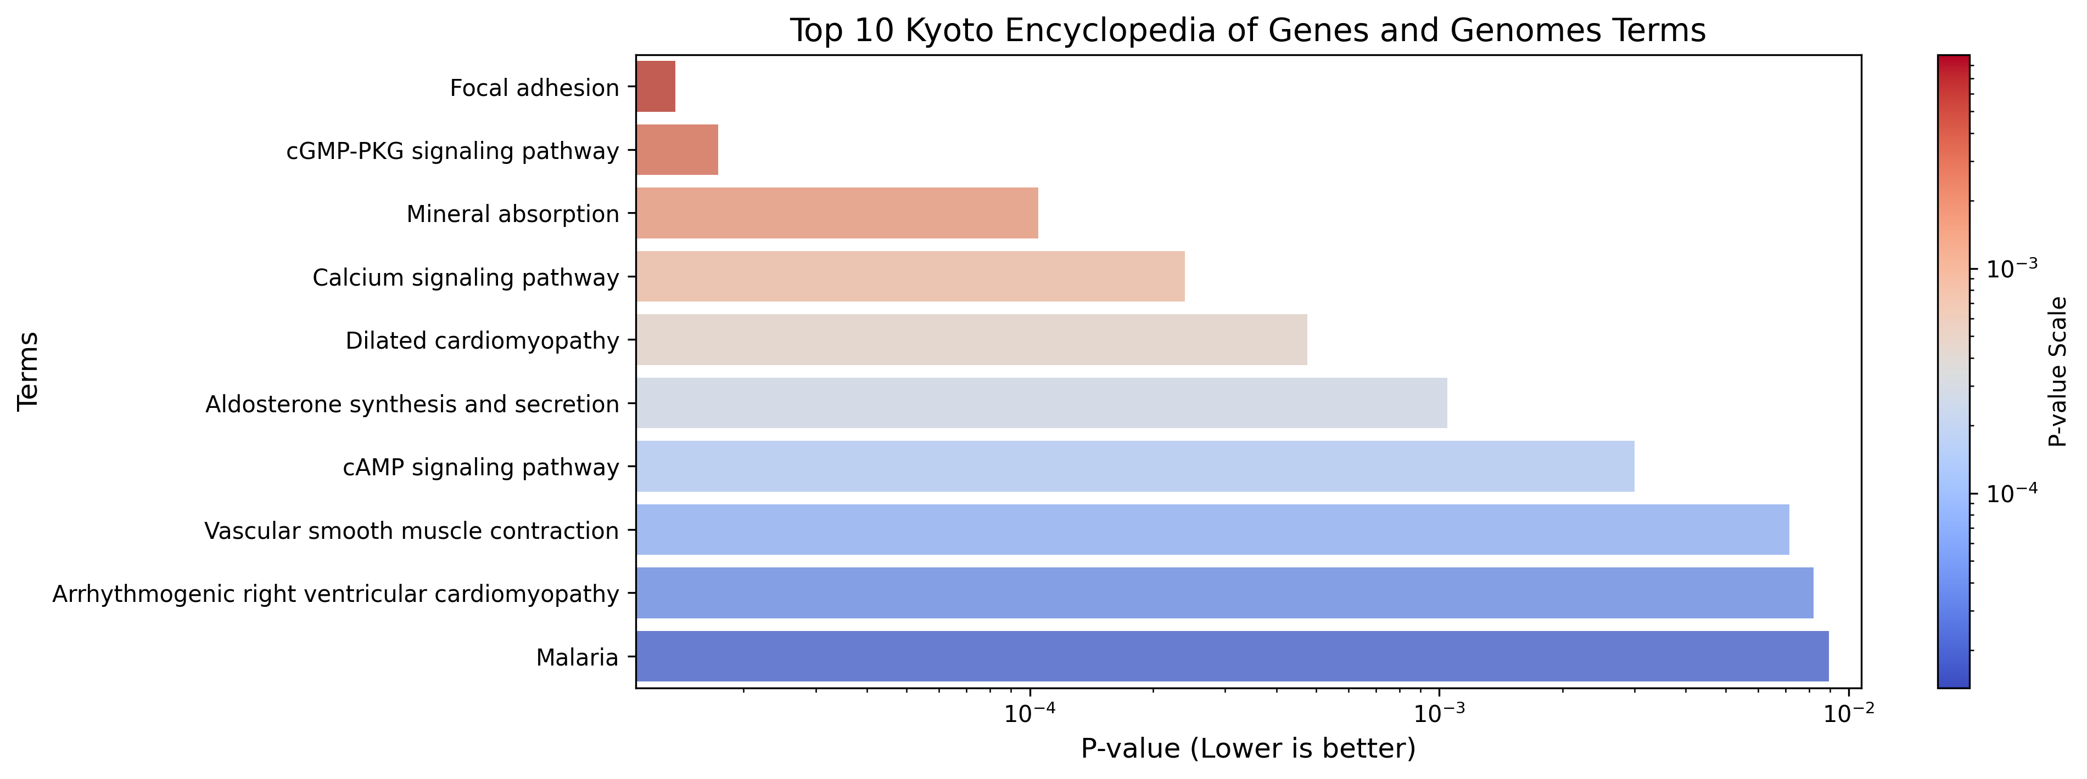
Result Evaluation (cont..)
KEGG in Downregulated Genes:
Downregulated genes were significantly associated with pathways those findings suggest suppression of signaling pathways important for cell adhesion, ion transport, and cardiovascular function.
Figure 6.10: Top KEGG terms for downregulated DEGs
Department Of Computer Science and Engineering, JnU
21

Slide 21
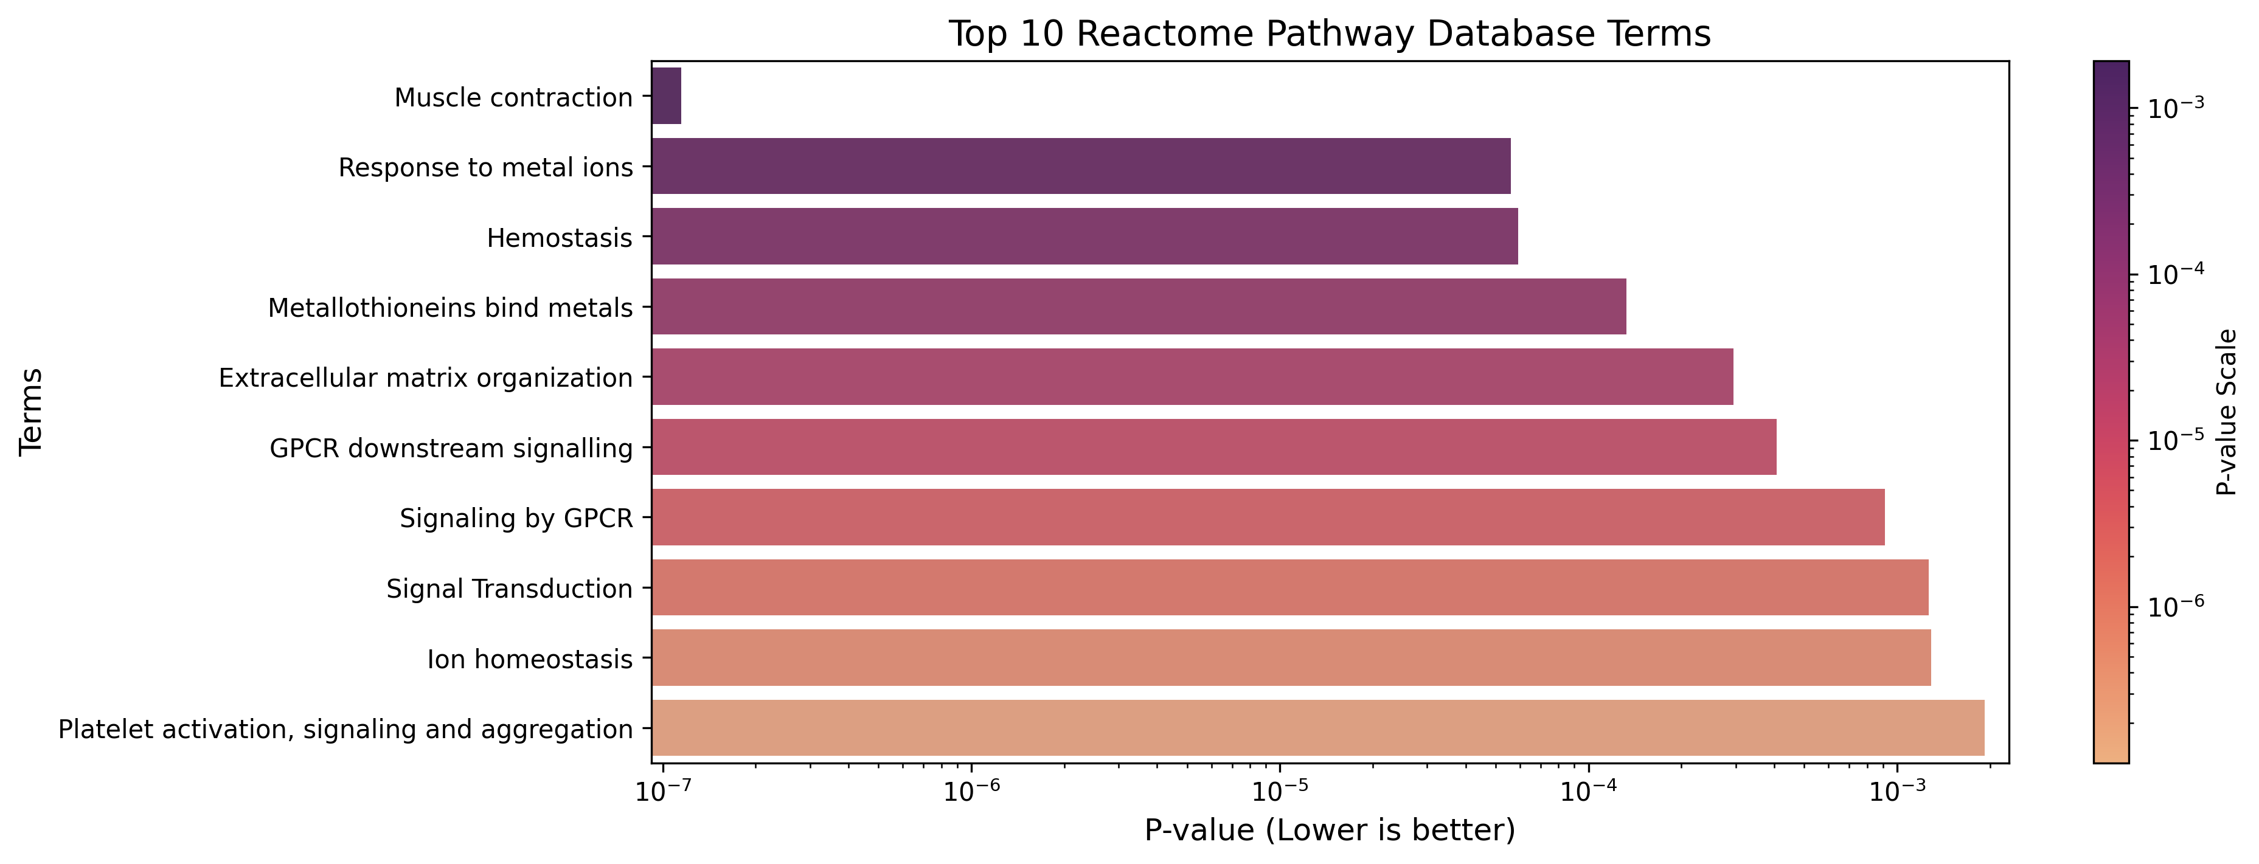
Result Evaluation (cont..)
REAC in Downregulated Genes:
Enriched REAC terms among downregulated genes results further support reduced activity in muscle function and extracellular signal communication pathways.
Figure 6.11: Top REAC terms for downregulated DEGs
Department Of Computer Science and Engineering, JnU
22

Slide 22
Result Evaluation (cont..)
Gene Co-expression Relationship Mapping
In this part an adjacency matrix was constructed where edges exist if correlation > 0.8 (absolute value). Then mapped a gene co-expression relationship using this adjacency matrix.
Calculated degree centrality for each gene (i.e., number of strong connections it has).
Selected the top 100 genes with the highest degree centrality — these are the most "hub-like" genes in the network.
Department Of Computer Science and Engineering, JnU
23
Department Of Computer Science and Engineering, JnU

Slide 23
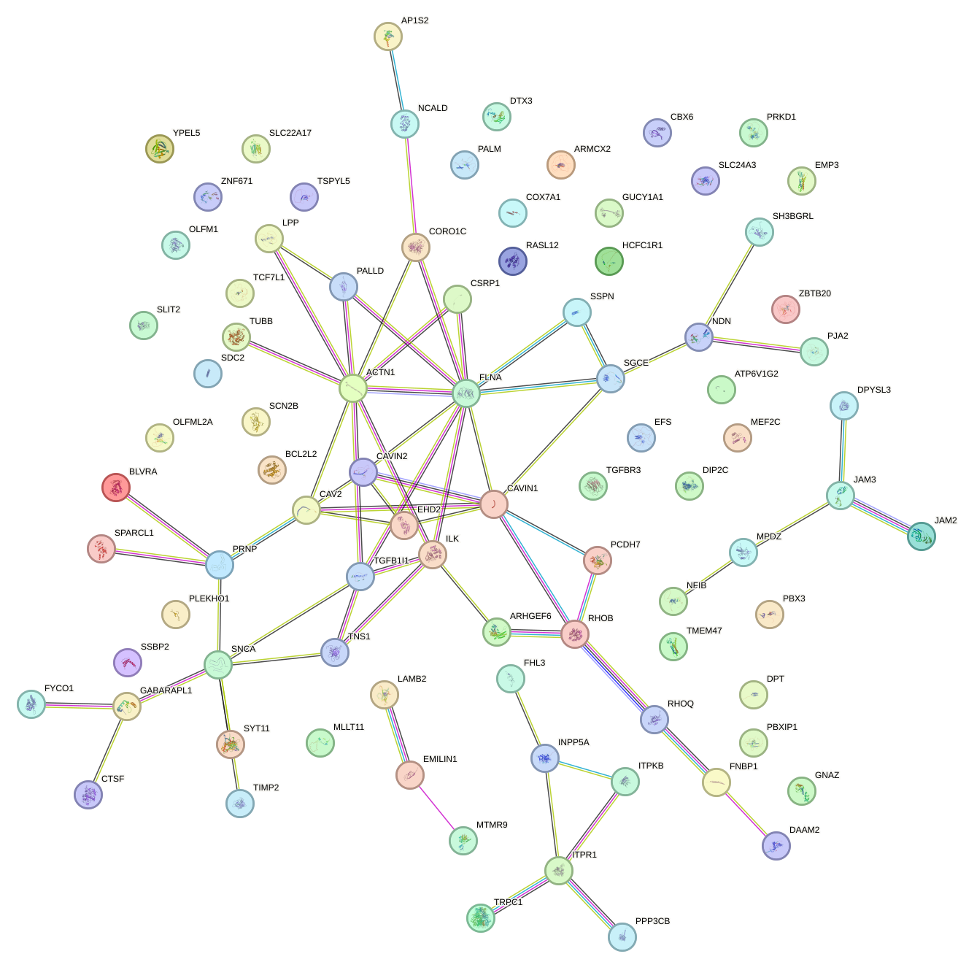
Result Evaluation (cont..)
PPI network Construction
After gene co-expression relationship mapping, the Protein-Protein Interaction network was drawn.
88 genes were obtained by this approach.
Top Hub Genes Identification
88 genes were found in the previous step, then in this step 3 ranking methods were used. Closeness, MCC and MNC. For each method, the top 10, 20, 30 and 40 genes were evaluated. So, for each method, 4 sets of genes were obtained.
Figure 6.12: PPI Network
Department Of Computer Science and Engineering, JnU
24

Slide 24
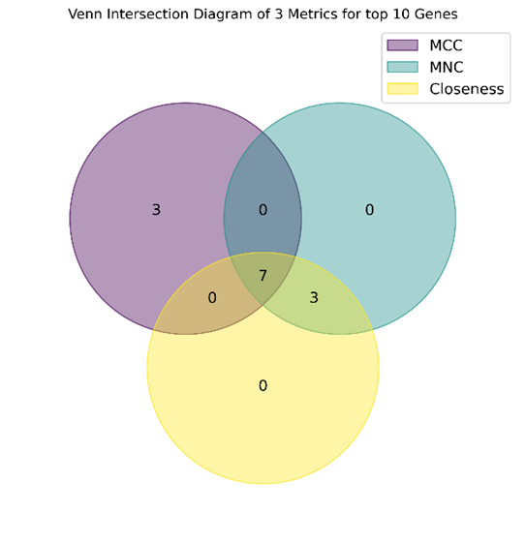

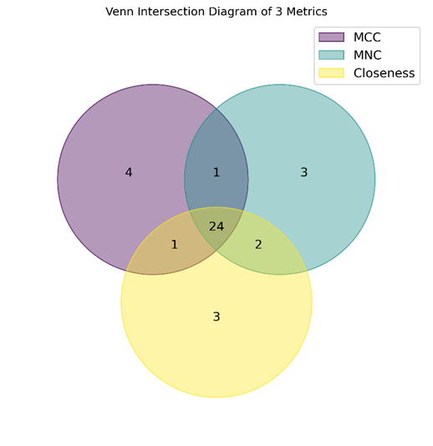

Result Evaluation (cont..)
Figure 6.13: Venn Diagram of 3 ranking methods of top 10 genes
Figure 6.14: Venn Diagram of 3 ranking methods of top 20 genes
Figure 6.15: Venn Diagram of 3 ranking methods of top 30 genes
Figure 6.16: Venn Diagram of 3 ranking methods of top 40 genes
Department Of Computer Science and Engineering, JnU
25

Slide 25
Result Evaluation (cont..)
After evaluating the 4 set of hub genes, we sent them for machine learning and ensemble learning training.
Feature Selection
In this step 5 feature selections were applied in our DEGs and then we found 5 set of features (gene signatures).
Feature Selection
Pearson Correlation (15)
ElasticNet (25)
LASSO Regression (12)
mRMR (27)
Mutual Information (6)
Figure 6.17: Feature selection methods and quantity of the features with each method
Department Of Computer Science and Engineering, JnU
27

Slide 26

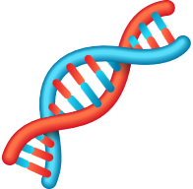
Result Evaluation (cont..)
Training Models
Hyper-Parameter Tuning
Independent Test Datasets
Training Set 70%
LR
AdaBoost
GSE106582
KNN
Bagging
GSE21815
Extra Trees
Validation Set 30%
Grid Search CV
RF
GSE8671
Gradient Boost
XGBoost
Random Search CV
10-fold (Cross validation)
GSE44076
Figure 6.18: Training and Testing phase
As previously mentioned, we used 4 independent dataset for testing, so first the training and testing were performed with base models. Then the models were trained and tested with hyper-parameter tuning .
After all this phase, the evaluation part started.
Department Of Computer Science and Engineering, JnU
29
Department Of Computer Science and Engineering, JnU

Slide 27
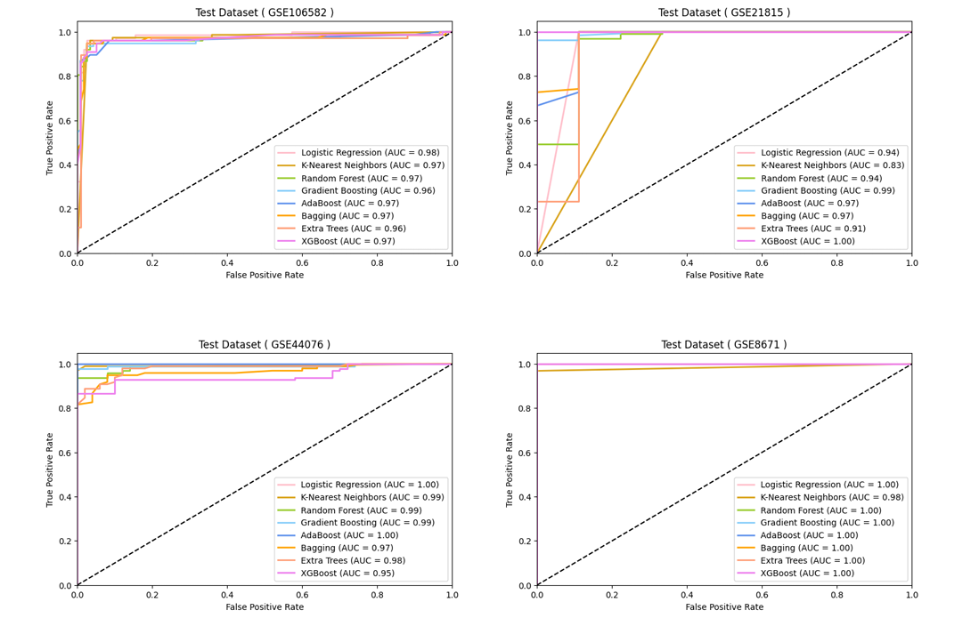
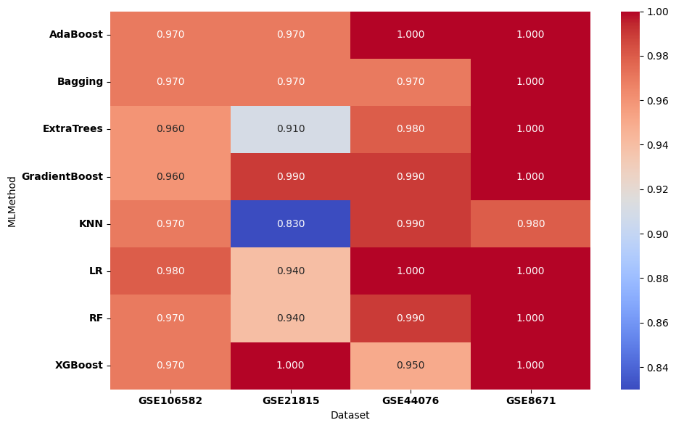
Result Evaluation (cont..)
Figure 6.19 : AUC-ROC Heatmap of ML Models Across Datasets
Figure 6.20: AUC-ROC curve for Gene subsets (6 genes) for four test datasets
Department Of Computer Science and Engineering, JnU
30

Slide 28
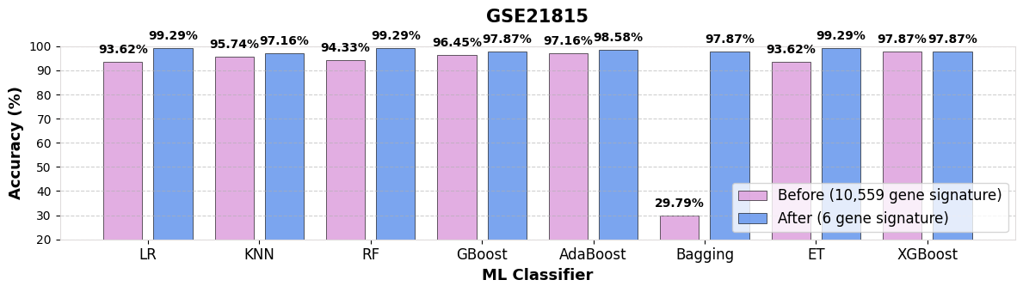
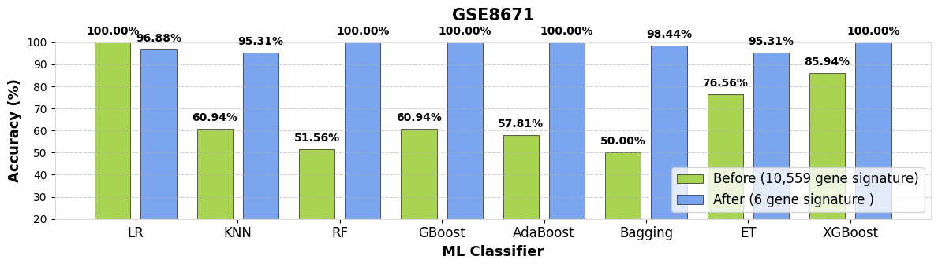
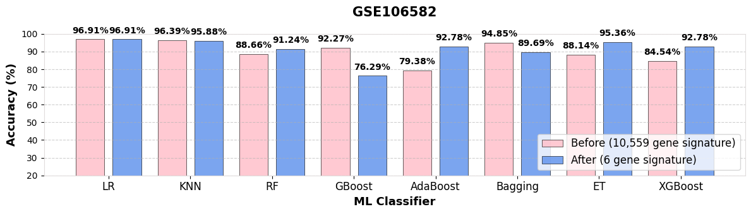
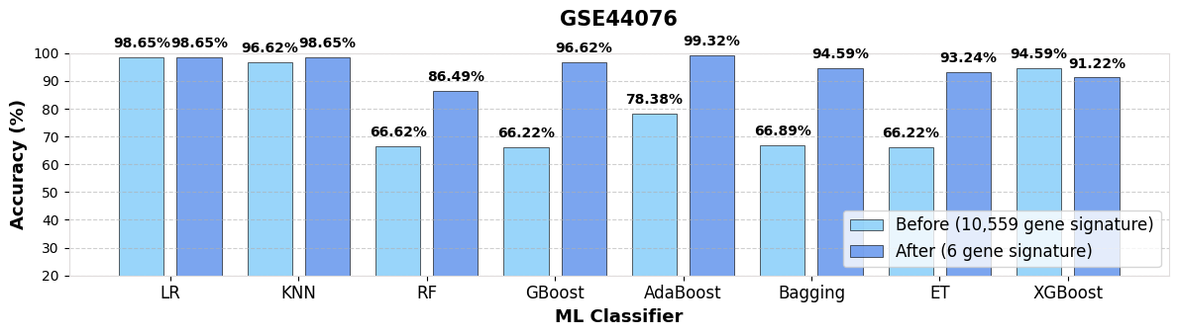
Result Evaluation (cont..)
Figure 6.21 : Accuracy comparison of all features vs selective features for 4 datasets
Department Of Computer Science and Engineering, JnU
32

Slide 29
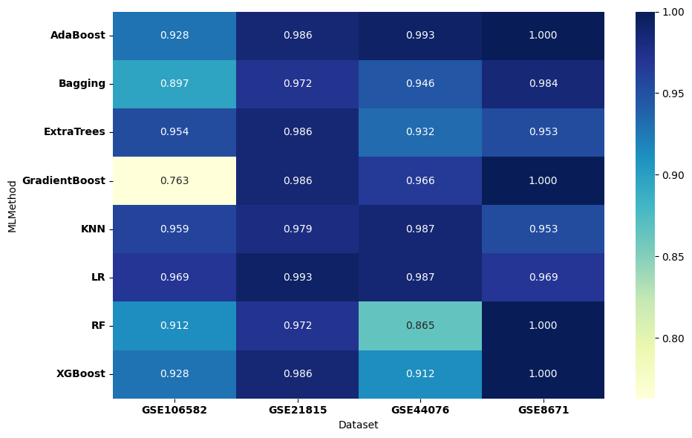
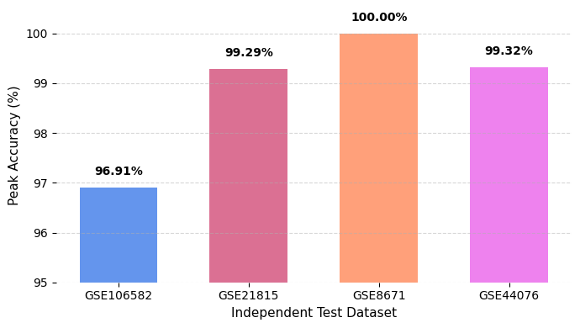
Result Evaluation (cont..)
Figure 6.22: Accuracy Heatmap of ML Models Across Datasets
Figure 6.3 : Peak accuracy with 6 candidate gene signature
Department Of Computer Science and Engineering, JnU
36

Slide 30
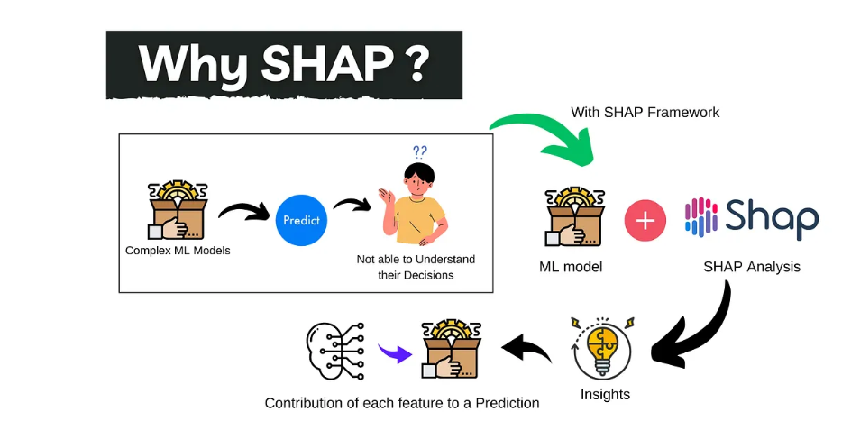
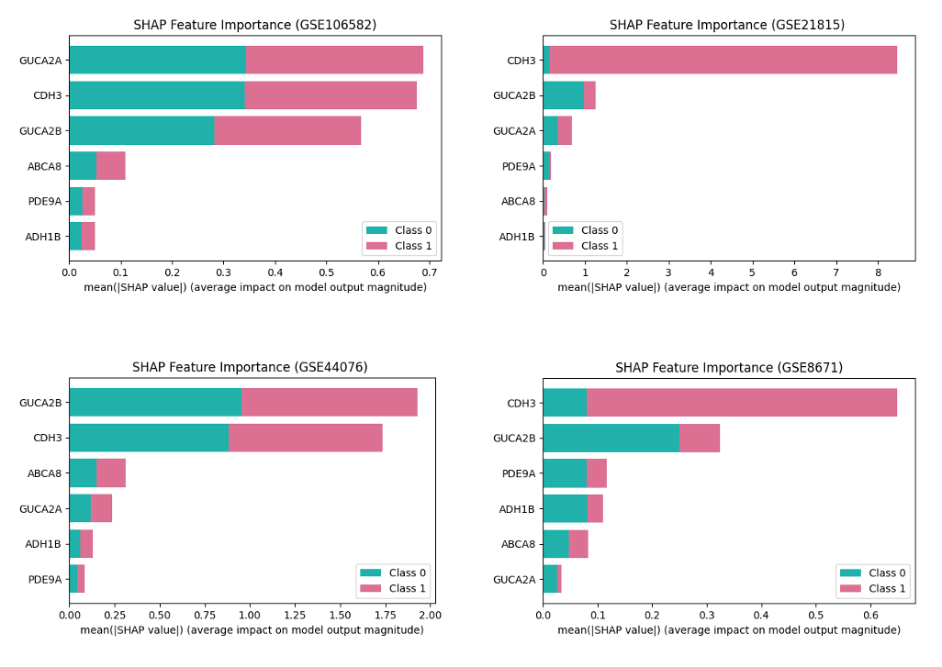
Model Interpretation
Figure 7.1: SHAP stacked bar chart for four independent test datasets.
Department Of Computer Science and Engineering, JnU
37

Slide 31
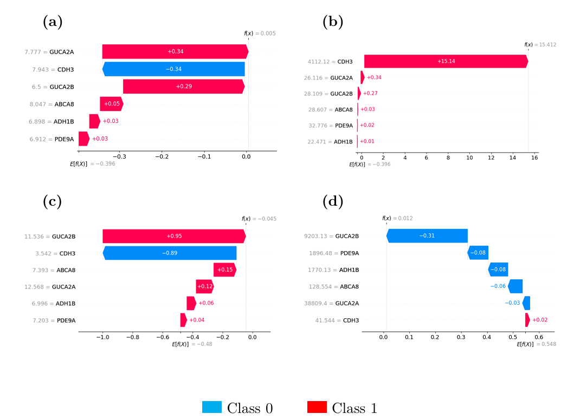
Model Interpretation(Cont..)
The SHAP waterfall plot allows to assess the incremental effect of each feature on the model’s output
Aiding in model optimization and debugging.
Positive contributions are depicted as bars that push the prediction higher, while negative contributions are represented as bars that pull the prediction lower.
Figure 7.2 : SHAP Waterfall chart for 4 independent test datasets: (a) GSE106582, (b) GSE21815, (c) GSE44076, (d) GSE8671.
Department Of Computer Science and Engineering, JnU
37

Slide 32
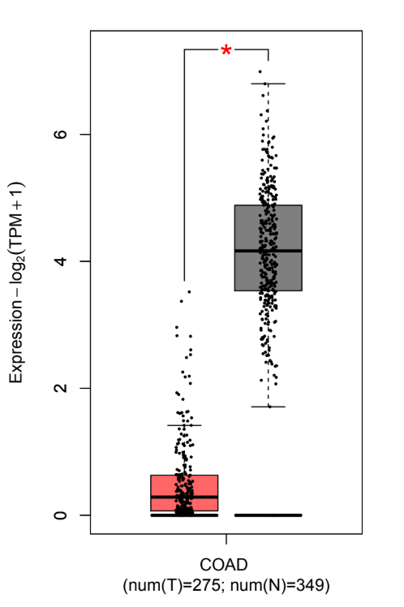
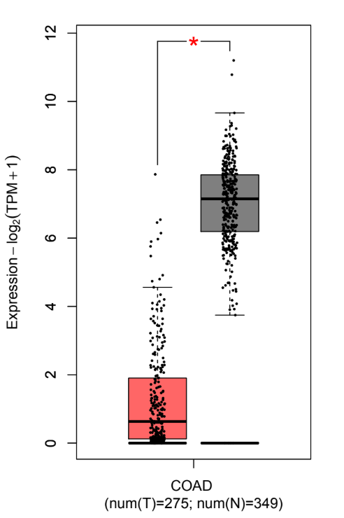
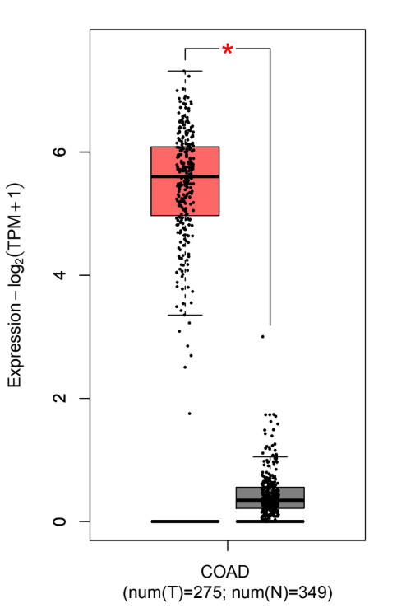
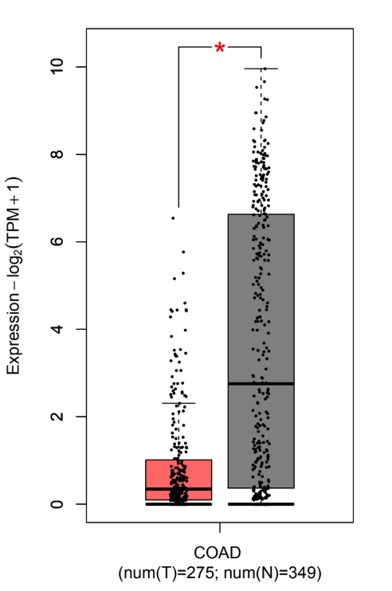
Biological Validation
(a) ABCA8
(b) ADH1B
(c) CDH3
(d) GUCA2A
Figure 8.1 : Validating 6 candidate genes using GEPIA2 (part-1)
Department Of Computer Science and Engineering, JnU
38

Slide 33
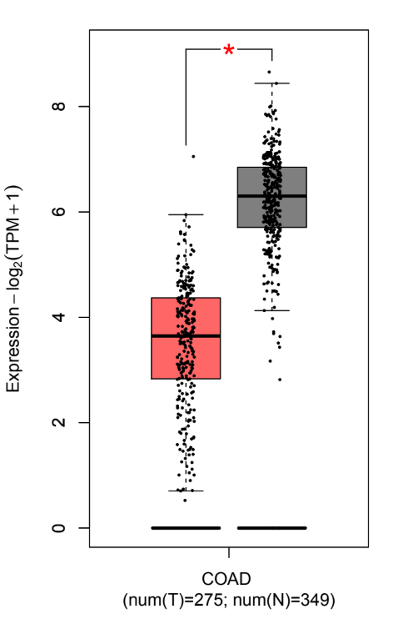
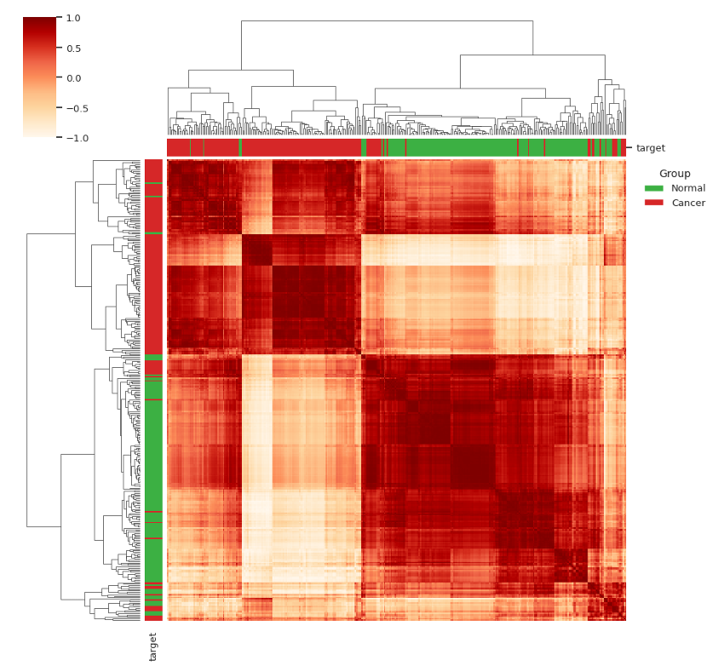
Biological Validation (cont..)
(e) GUCA2B
(f) PDE9A
Figure 8.2 : Validating 6 candidate genes using GEPIA2 (part-2).
Figure 8.3 : Unsupervised Sample Validation using Hierarchical Clustering with 6 candidate genes
Department Of Computer Science and Engineering, JnU
38

Slide 34
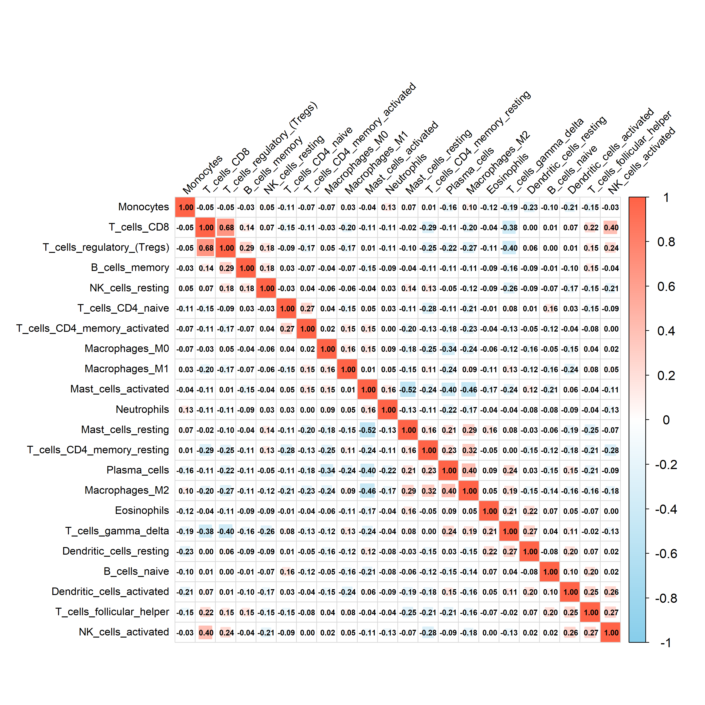
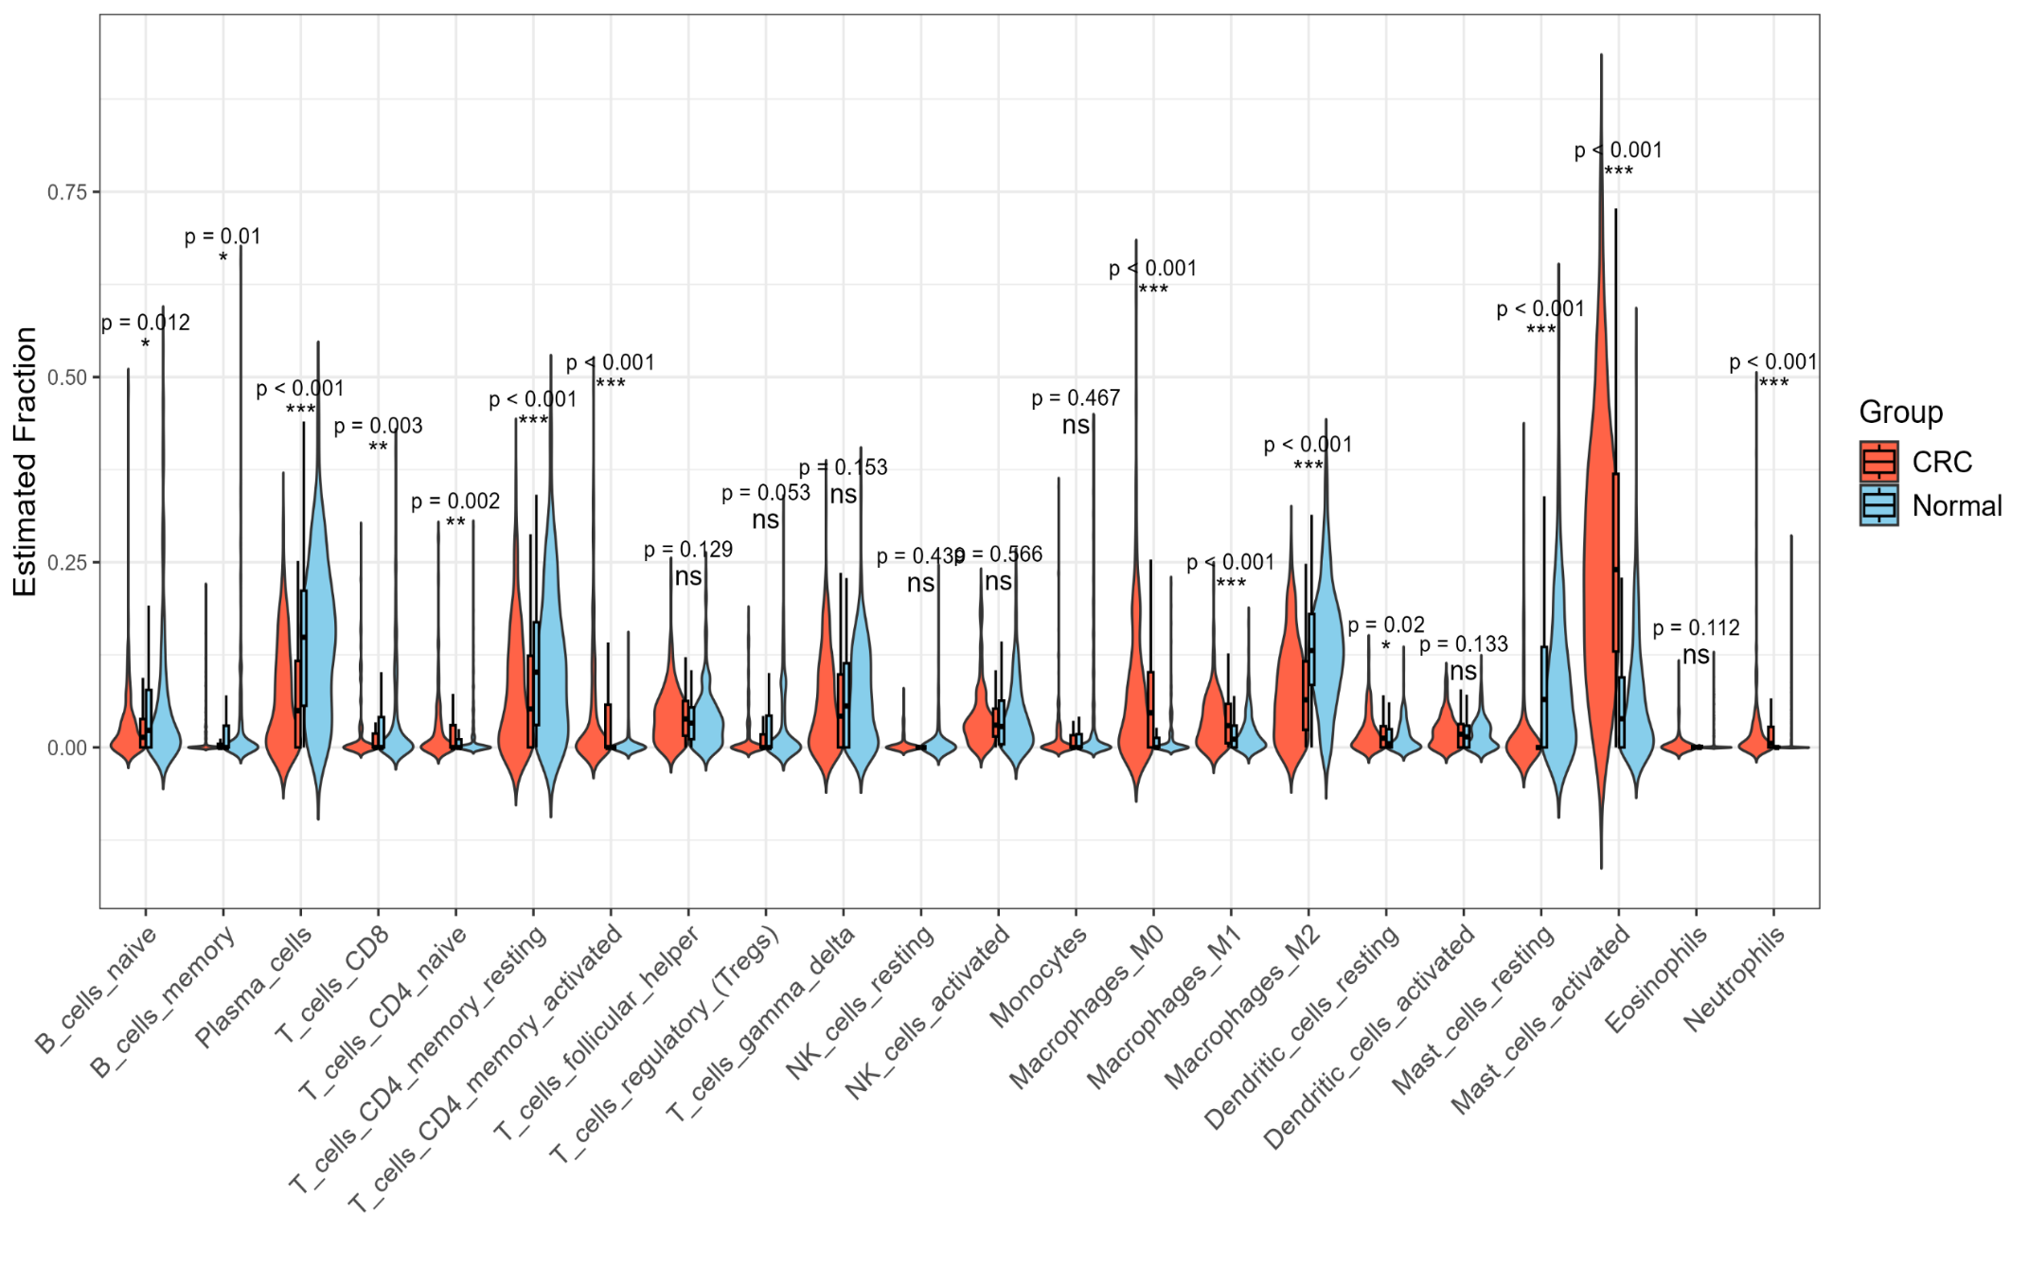
Immune Infiltration Analysis
Figure 8.4 : Violin plot differences in 22 types of immune cells
Figure 8.5 : Correlation heatmap between 22 types of immune cells.
Department Of Computer Science and Engineering, JnU
38

Slide 35
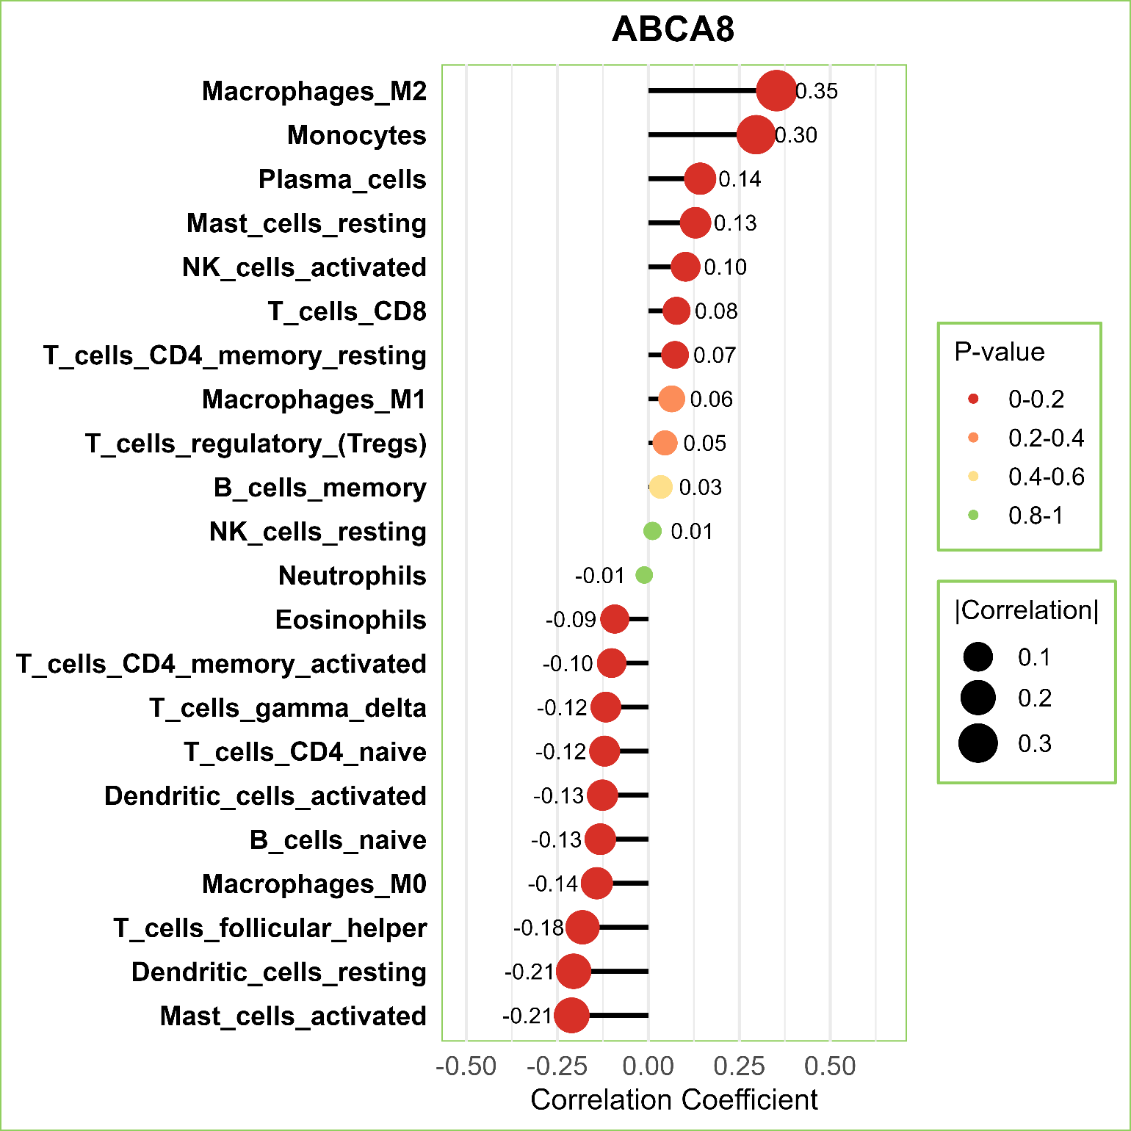
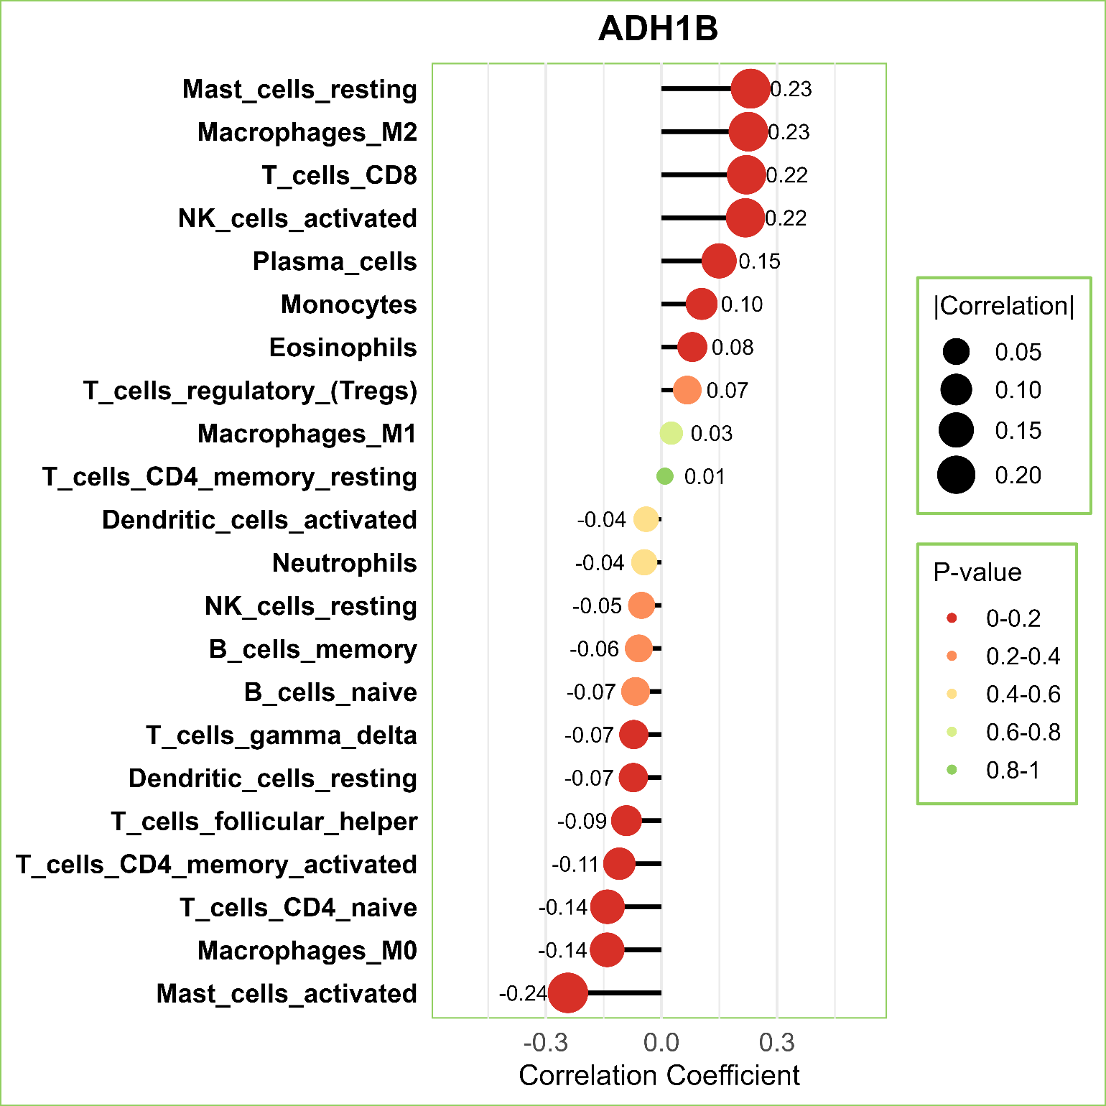
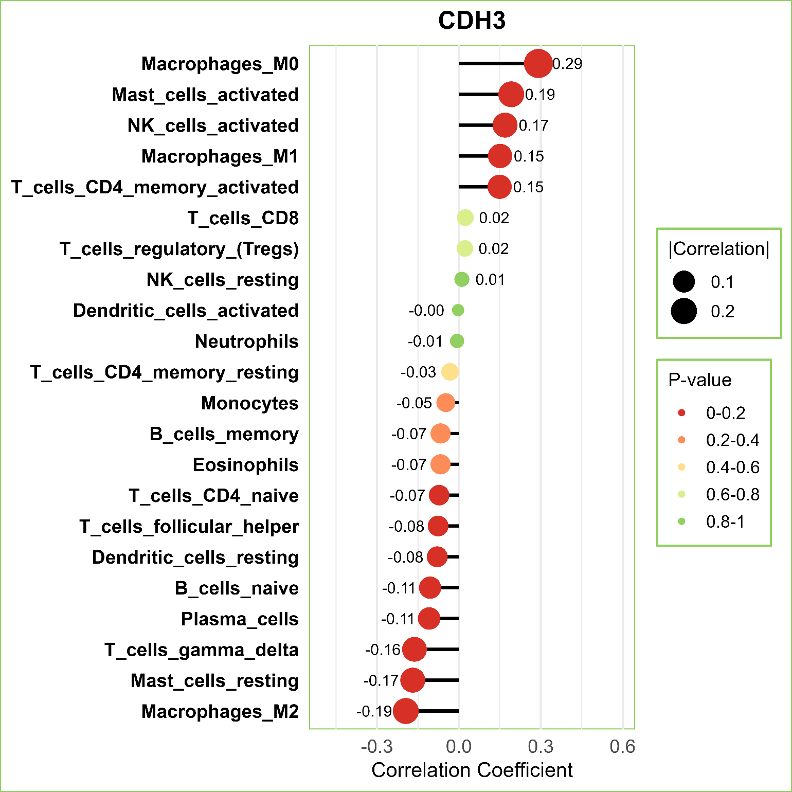
Immune Infiltration Analysis (cont..)
Figure 8.6 : Correlation between 6 diagnostic genes and immune cells (part-1)
Department Of Computer Science and Engineering, JnU
38

Slide 36
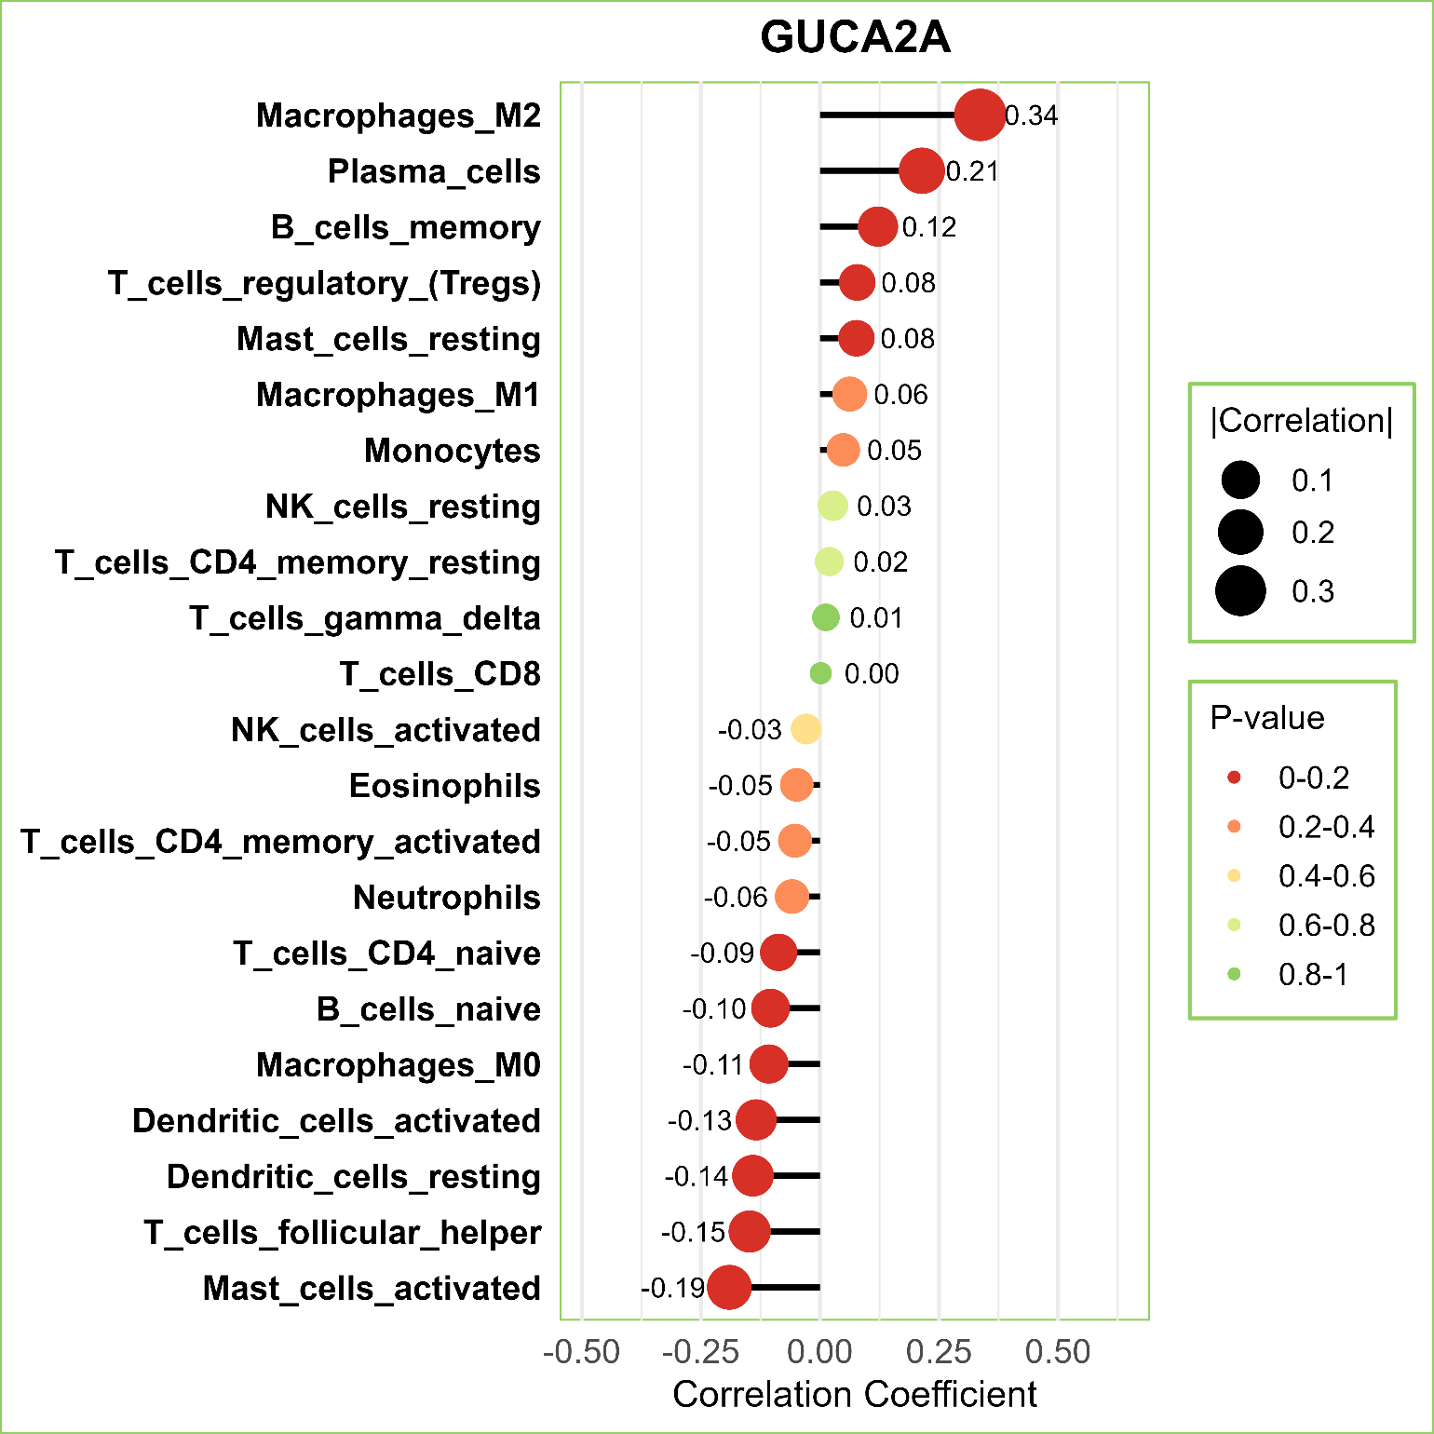
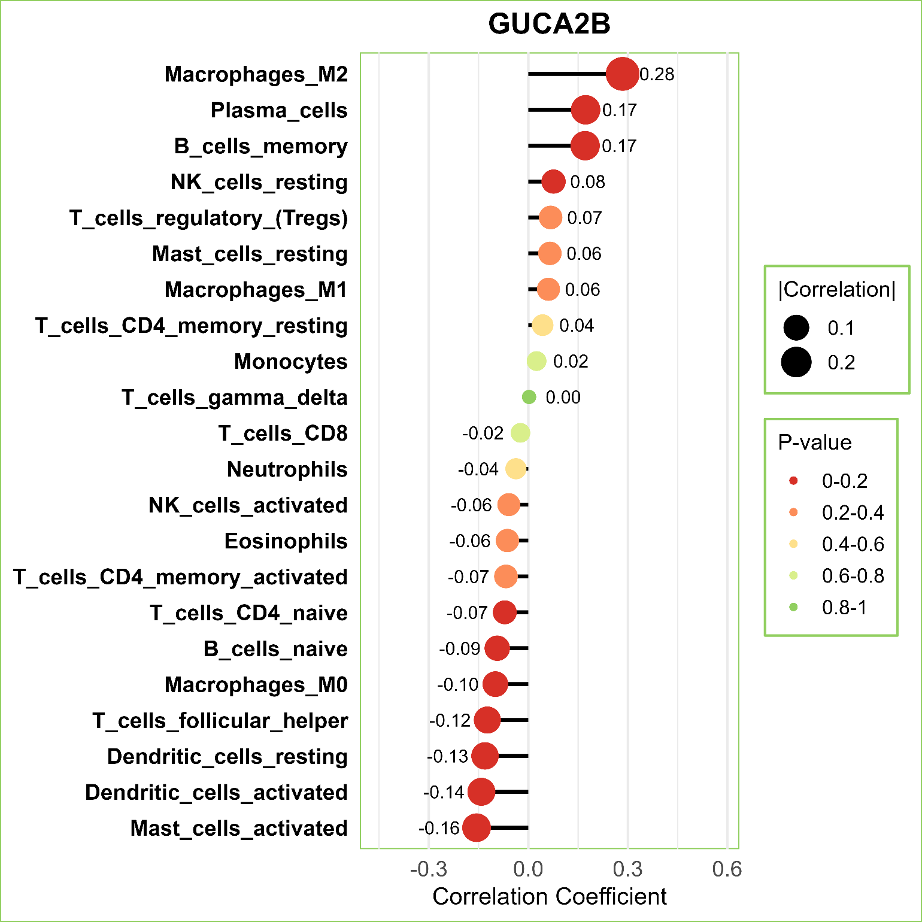
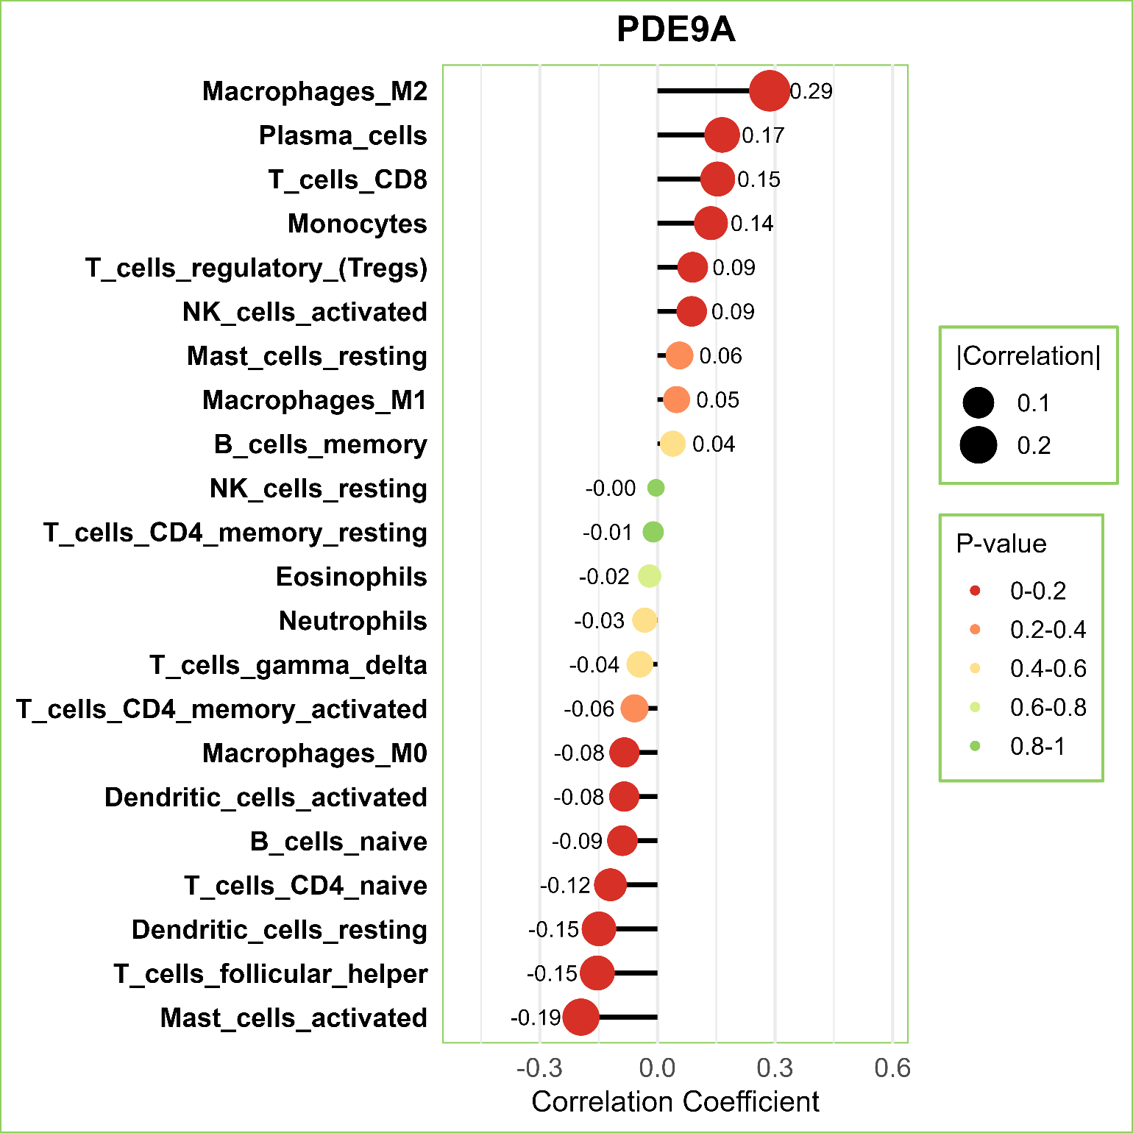
Immune Infiltration Analysis (cont..)
Figure 8.7 : Correlation between 6 diagnostic genes and immune cells (part-2)
Department Of Computer Science and Engineering, JnU
38

Slide 37
Discussion
Results Analysis with related papers
Authors | FS Methods | Diagnostic Genes | Accuracy | Best Algorithms(s)
Vaziri-Moghadam et al. [3] | Hybrid Bio-informatics based | 9 | 95.8%-97.8% | RF
Minh et al. [4] | HMLFSM (Hybrid) | 60 | 93.9 | Naive Bayes
Wei et al. [5] | MDI-Bruta | 34 | 96.4%-98.2% | RF
Radhakrishnan et al. [6] | SHapley Additive exPlanations (SHAP) | 7 | 94.87% | LASSO
Our Study | MI-DEGs ( Hybrid Bio-informatics +Mutual Information) | 6 | 96.91%-100%* | Multiple models (LR, AdaBoost, RF, GB, XGBoost)
Table 9.1: Comparison with Related Papers
Department Of Computer Science and Engineering, JnU
39

Slide 38
Discussion(Cont..)
Paper (Title) | Unique Contribution Compared to existing Paper
“Integrating machine learning and bioinformatics approaches for identifying novel diagnostic gene biomarkers in colorectal cancer” [3] | Merged 7 GEO datasets fir training instead of 1–2, Performed model interpretation using SHAP for transparent decision-making
“A hybrid machine learning feature selection model—HMLFSM to enhance gene classification applied to multiple colon cancers dataset” [4] | Broader gene validation pipeline beyond FS (GEPIA2 + immune analysis), Used independent dataset to assess performance, not just cross-validation
“Machine learning-based identification of colon cancer candidate diagnostics genes” [5] | Identified fewer but highly validated diagnostic genes, Linked gene expression with immune cell correlation (IOBR)
“Machine learning-based identification of proteomic markers in colorectal cancer using UK Biobank data” [6] | Focused on gene expression (transcriptomic) data with GEO datasets, Performed cross-platform validation using external datasets
Table 9.2: Comparison with Related Papers
Department Of Computer Science and Engineering, JnU
39

Slide 39
Conclusion and Future Work
An analytical framework is designed, implemented and evaluated. A combination of bioinformatics and machine learning approaches identified 6 influential gene signatures, including ADH1B, CDH3, GUCA2B, PDE9A, ABCA8 and GUCA2A.
4 independent test datasets are used to evaluate this research showing 96.91% to 100% accuracy.
The models are interpreted by Explainable AI i.e. SHAP features importance and SHAP waterfall chart.
Also , GEPIA2 was used to validate these 6 genes showing they are statistically significant (p value < 0.05).
Then immune infiltration was followed by these 6 genes. Consequently, these 6 biomarkers are anticipated as influential markers for CRC.
Future work can extend this to multi-omics data and clinical validation for more personalized cancer diagnostics.
Department Of Computer Science and Engineering, JnU
40

Slide 40
References
[1] | https://www.wcrf.org/preventing-cancer/cancer-statistics/colorectal-cancer-statistics/
[2] | Sweeney SM, Hamadeh HK, Abrams N, Adam SJ, Brenner S, Connors DE, Davis GJ, Fiore LD, Gawel SH, Grossman RL, Hanlon SE, Hsu K, Kelloff GJ, Kirsch IR, Louv B, McGraw D, Meng F, Milgram D, Miller RS, Morgan E, Mukundan L, O'Brien T, Robbins P, Rubin EH, Rubinstein WS, Salmi L, Schaller TH, Shi G, Sigman CC, Srivastava S. Case Studies for Overcoming Challenges in Using Big Data in Cancer. Cancer Res. 2023 Apr 14;83(8):1183-1190. doi: 10.1158/0008-5472.CAN-22-1277. PMID: 36625851; PMCID: PMC10102839.
[3] | A. Vaziri-Moghadam and M. Foroughmand-Araabi, “Integrating machine learning and bioinformatics approaches for identifying novel diagnostic gene biomarkers in colorectal cancer,” Scientific Reports, vol. 14, p. 24786, 2024. [Online]. Available: https://www.nature.com/articles/s41598-024-75438-6
[4] | M. Al-Rajab, J. Lu, Q. Xu, M. Kentour, A. Sawsa, E. Shuweikeh, M. Joy, and R. Arasaradnam, “A hybrid machine learning feature selection model—hmlfsm to enhance gene classification applied to multiple colon cancers dataset,” PLOS ONE, vol. 18, no. 11, pp. 1–27, 11 2023. [Online]. Available: https://doi.org/10.1371/journal.pone.0286791
[5] | S. Koppad, A. Basava, K. Nash, G. V. Gkoutos, and A. Acharjee, “Machine learning-based identification of colon cancer candidate diagnostics genes,” Biology, vol. 11, no. 3, 2022. [Online]. Available: https: //www.mdpi.com/2079-7737/11/3/365
Department Of Computer Science and Engineering, JnU
41

Slide 41
References (Cont..)
[6] | S. K. Radhakrishnan, D. Nath, D. Russ, L. B. Merodio, S. Lad, F. Daisi, and A. Acharjee, “Machine learning-based identification of proteomic markers in colorectal cancer using uk biobank data,” Frontiers in Oncology, 2025.
[7] | P. Bera, S. Debnath, C. Mal et al., “Integrating relieff-based feature selection and ensemble machine learning for robust biomarker identification in colorectal cancer,” Network Modeling Analysis in Health Informatics and Bioinformatics, vol. 14, p. 40, 2025. [Online]. Available: https: //doi.org/10.1007/s13721-025-00533-1
[8] | H. L. Hyelim Chun, Minha Lea Yoon, J. Y. L. Woo Jeong Seo, and J. H. Yoon, “Identification and validation of serum biomarkers to improve colorectal cancer diagnosis,” Cancer Medicine, vol. 13, no. 23, p. e70460, 2024
[9] | M. A. M. Hasan, M. Maniruzzaman, and J. Shin, “WGCNA and machine learning-based integrative bioinformatics analysis for identifying key genes of colorectal cancer,” IEEE Access, vol. 12, pp. 144 350–144 363, 2024. [Online]. Available: https://doi.org/10.1109/ACCESS.2024.3472688
[10] | X. Du, H. Qi, W. Ji, P. Li, R. Hua, W. Hu, and F. Qi, “Construction of a colorectal cancer prognostic risk model and screening of prognostic risk genes using BIBLIOGRAPHY 155 machine-learning algorithms,” Journal of Healthcare Engineering, p. 9408839, 2022.
Department Of Computer Science and Engineering, JnU
41

Slide 42




THANK YOU
Department Of Computer Science and Engineering, JnU
42

